Slide 1

Addictions
Dr Robert Lundin
Consultant Psychiatrist
Alcohol and Other Drugs Integrated Treatment Team (AODITT)
rlundin@mbph.org.au

Slide 2



Topics
Your expectations / preferred topics
Addiction in Mildura
Why people get addicted
Withdrawal in ED
Local services
Other resources

Slide 3

Scale of problem
2005: Cost to Australian society of illicit drug use was estimated to be $6.9 billion, the cost of related crime comprised $3.6 billion of this.
2015: There were 48,522 people being treated with pharmacotherapy for opioid dependence in Australia.
2016: 1 in 10 (11%) Australians aged 14 and over had ever used at least 1 type of opioid for illicit or non-medical purposes.
One Australian dies every day due to harm from prescription opioids

Slide 4
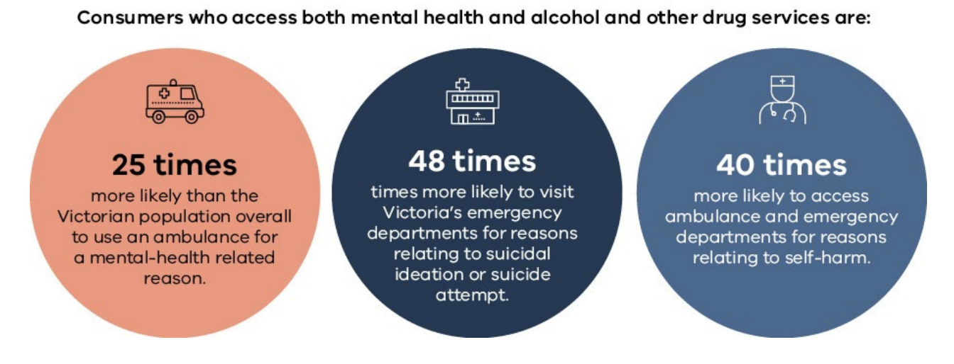
Evidence base
Royal commission considers integrated care considered more effective and cost-efficient

Slide 5
The context
The Mildura Local Government Area (LGA) has maintained rates of alcohol and drug-related ambulance attendance above the state-wide average for the past ten years (2011-2021) ¹
This rate peaked for Mildura in 2020 at 929.6 attendances per 100,000 people compared to 798.0 for Victoria, 779.9 for the metropolitan and 871.8 for the regional averages. ¹
The Mildura LGA has had lower rates of hospital admissions for drug-related concerns throughout the same period compared to the wider state, regional and metropolitan averages. ¹
The proportion of the Mildura population who are at increased risk of alcohol-related harm is 44.3% for women and 71.7% for men.²
1 Turning Point (2024). AODstats: Victorian alcohol and drug statistics, www.aodstats.org.au. Date accessed: 07/03/2024
2 State of Victoria, Australia, Department of Health (2023). Victorian Population Health Survey 2017 https://www.health.vic.gov.au/population-health-systems/victorian-population-health-survey Date accessed: 07/03/2024

Slide 6
Tolerance vs Dependence
Dependence
Expected with daily opioid use beyond 4 weeks
Physical dependence is evident when stopping a substance elicits withdrawal symptoms
Psychological dependence refers to the experience of impaired control over substance use
Behavioural, cognitive, physical and psychological issues develop with repeated opioid use
Tolerance
Adaptive physiological change where the body becomes less affected by the presence of a drug or medicine
A need for increasing amounts of opioid to achieve desired effect
After prolonged use, many drugs can cause dependence. People who use a drug regularly can develop dependence and tolerance to it.

Slide 7

Substance Use disorder DSM5 Criteria
Opioids are often taken in larger amounts or over a longer period of time than intended.
There is a persistent desire or unsuccessful efforts to cut down or control opioid use.
A great deal of time is spent in activities necessary to obtain the opioid, use the opioid, or recover from its effects.
Craving, or a strong desire to use opioids.
Recurrent opioid use resulting in failure to fulfil major role obligations at work, school or home.

Slide 8
Substance Use disorder DSM5 Criteria Continued
Continued opioid use despite having persistent or recurrent social or interpersonal problems caused or exacerbated by the effects of opioids.
Important social, occupational or recreational activities are given up or reduced because of opioid use.
Recurrent opioid use in situations in which it is physically hazardous.
Continued use despite knowledge of having a persistent or recurrent physical or psychological problem that is likely to have been caused or exacerbated by opioids.

Slide 9
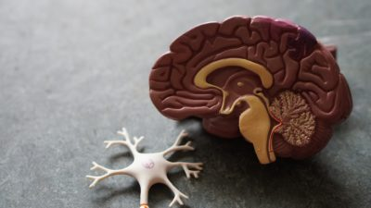
Neurophysiology of Addictive Behaviours
Identification of the neurocircuits involved in key aspects of the dependence (addictive) process.
These neurocircuits are re-set in a profound and enduring way.
The field of addiction and its treatment increasingly recognize the functional similarities across addictive behaviours, including urges, cravings, impulsivity and emotional dysregulation; reduced negative affect and increase positive affect as a result of engaging in the behavior; and similar activation of the brain's reward circuitry.

Slide 10
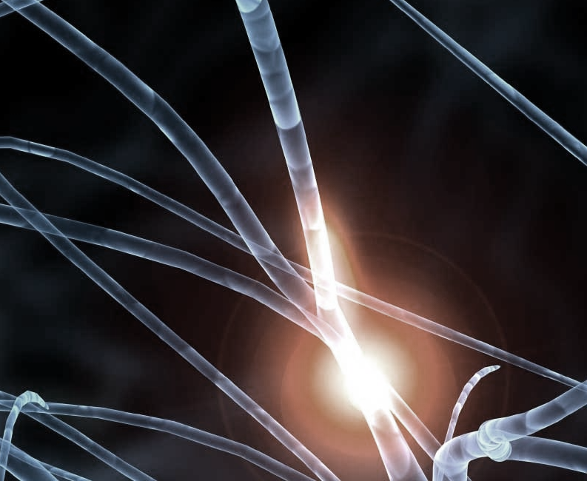
Neurobiological Mechanisms of Dependence 1: Re-setting of the Reward Neurocircuitry
Psychoactive substances initially activate reward pathways.
The two principal pathways are the dopaminergic system (especially relevant for psychostimulants and nicotine) and the opioid system (most relevant for alcohol and opioids).
With repeated use of these substances, the activity of these systems is suppressed, and more substance is required to maintain the normal state.
Normal activities with rewarding effects become blunted or ineffective.
A negative mood and motivational state ensues.
The reward system is re-set in a profound and enduring way.
Notes:
Drive for control and self worth

Slide 11
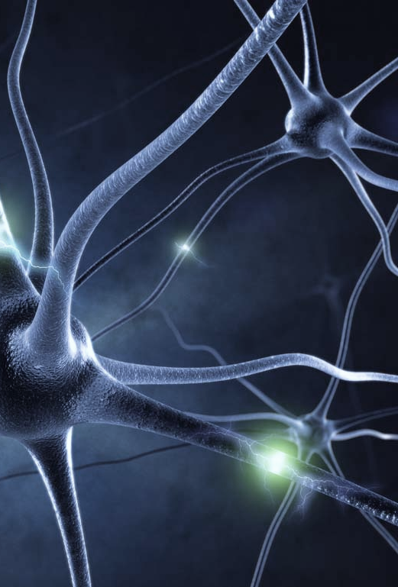
Neurobiological Mechanisms of Dependence 2: Up-regulation of the Alertness (Excitatory) Systems
Most psychoactive substances suppress the excitatory systems of the brain
With repeated substance use there is activation of brain stress pathways involving glutamatergic transmission (glutamate is the main excitatory neurotransmitter).
There is also suppression (uncoupling) of the natural anti-stress systems, including the GABA and Neuropeptide Y circuits.
This results in heightened activation from exposure to cues (“triggers”) for substance use.

Slide 12
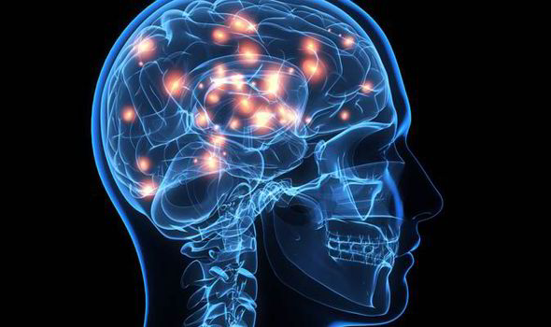
Neurobiological Mechanisms of Dependence 3: Re-setting of the Salience (Prioritization) Pathways
These pathways course from the lower fore-brain to the cingulate gyrus
With repeated substance use there is a rebalancing of the salience neurocircuitry in favour of continued substance use over other activities.
This results in substance use being accorded a higher priority for thinking and action over other tasks and responsibilities.

Slide 13
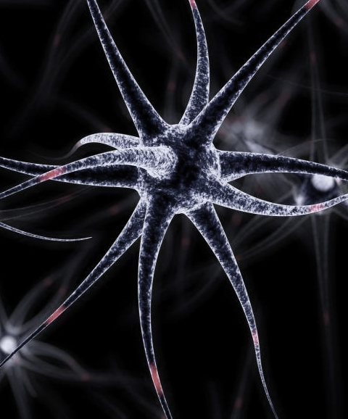
Neurobiological Mechanisms of Dependence 4: Impairment of Frontal Inhibitory pathways
With repeated substance use there is impairment of pre-frontal inhibitory pathways.
This results in even less control over the neurocircuits that are activated by dependence processes.
This may be associated contemporaneously (or subsequently) with deficiencies in executive functioning, decision-making, salience of substance use and insight.
Notes:
Practical vs emotional brain

Slide 14
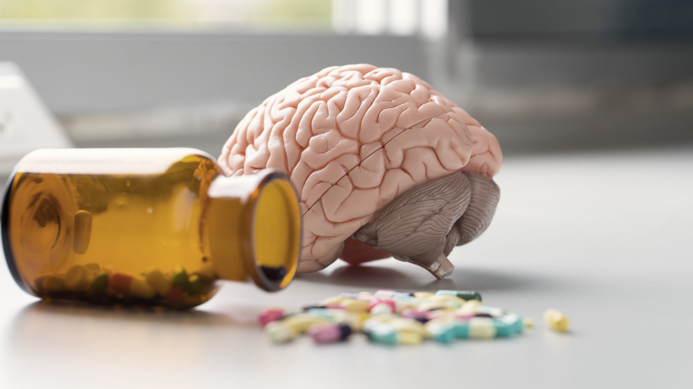
Neurophysiology
Repetitive substance use induces profound and persistent changes in the (i) reward, (ii) excitatory, (iii) salience, and (iv) behavioural inhibition pathways
The reward system becomes underactive because it has become “highjacked” by the addictive process.
The excitatory system is hyperactivated or “supercharged” in response to psychoactive substances and triggers for substance use.
The salience system is subverted: priorities are skewed.
This driving force is little influenced by the voluntary control, because of the impaired inhibitory system.
An “internal driving force” is generated, which directs and drives further substance use.

Slide 15
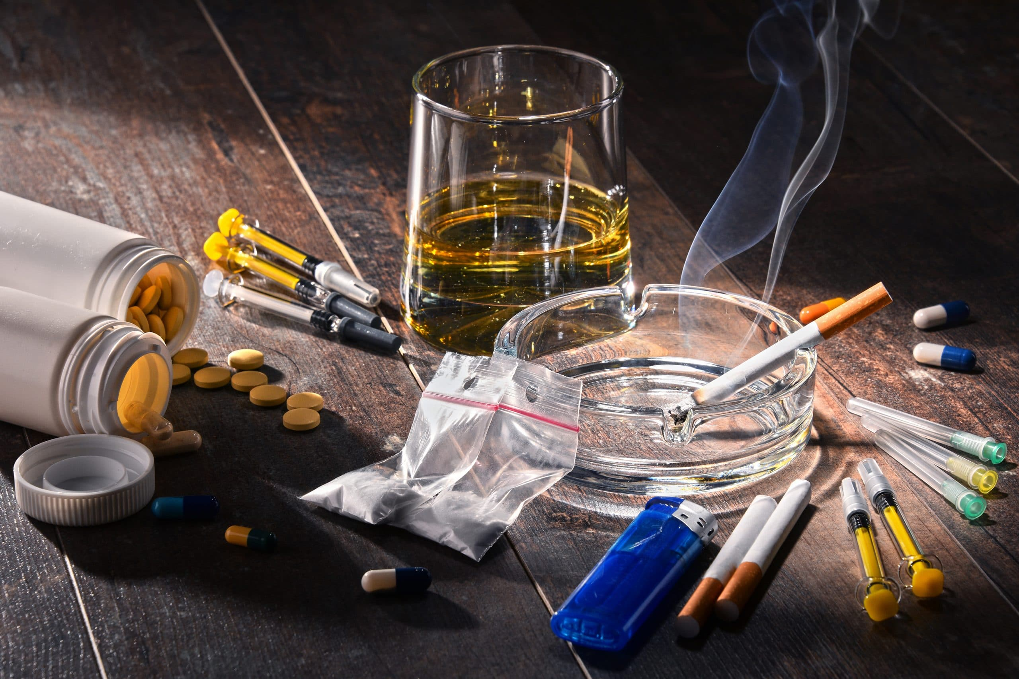
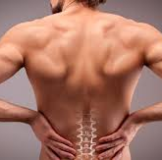
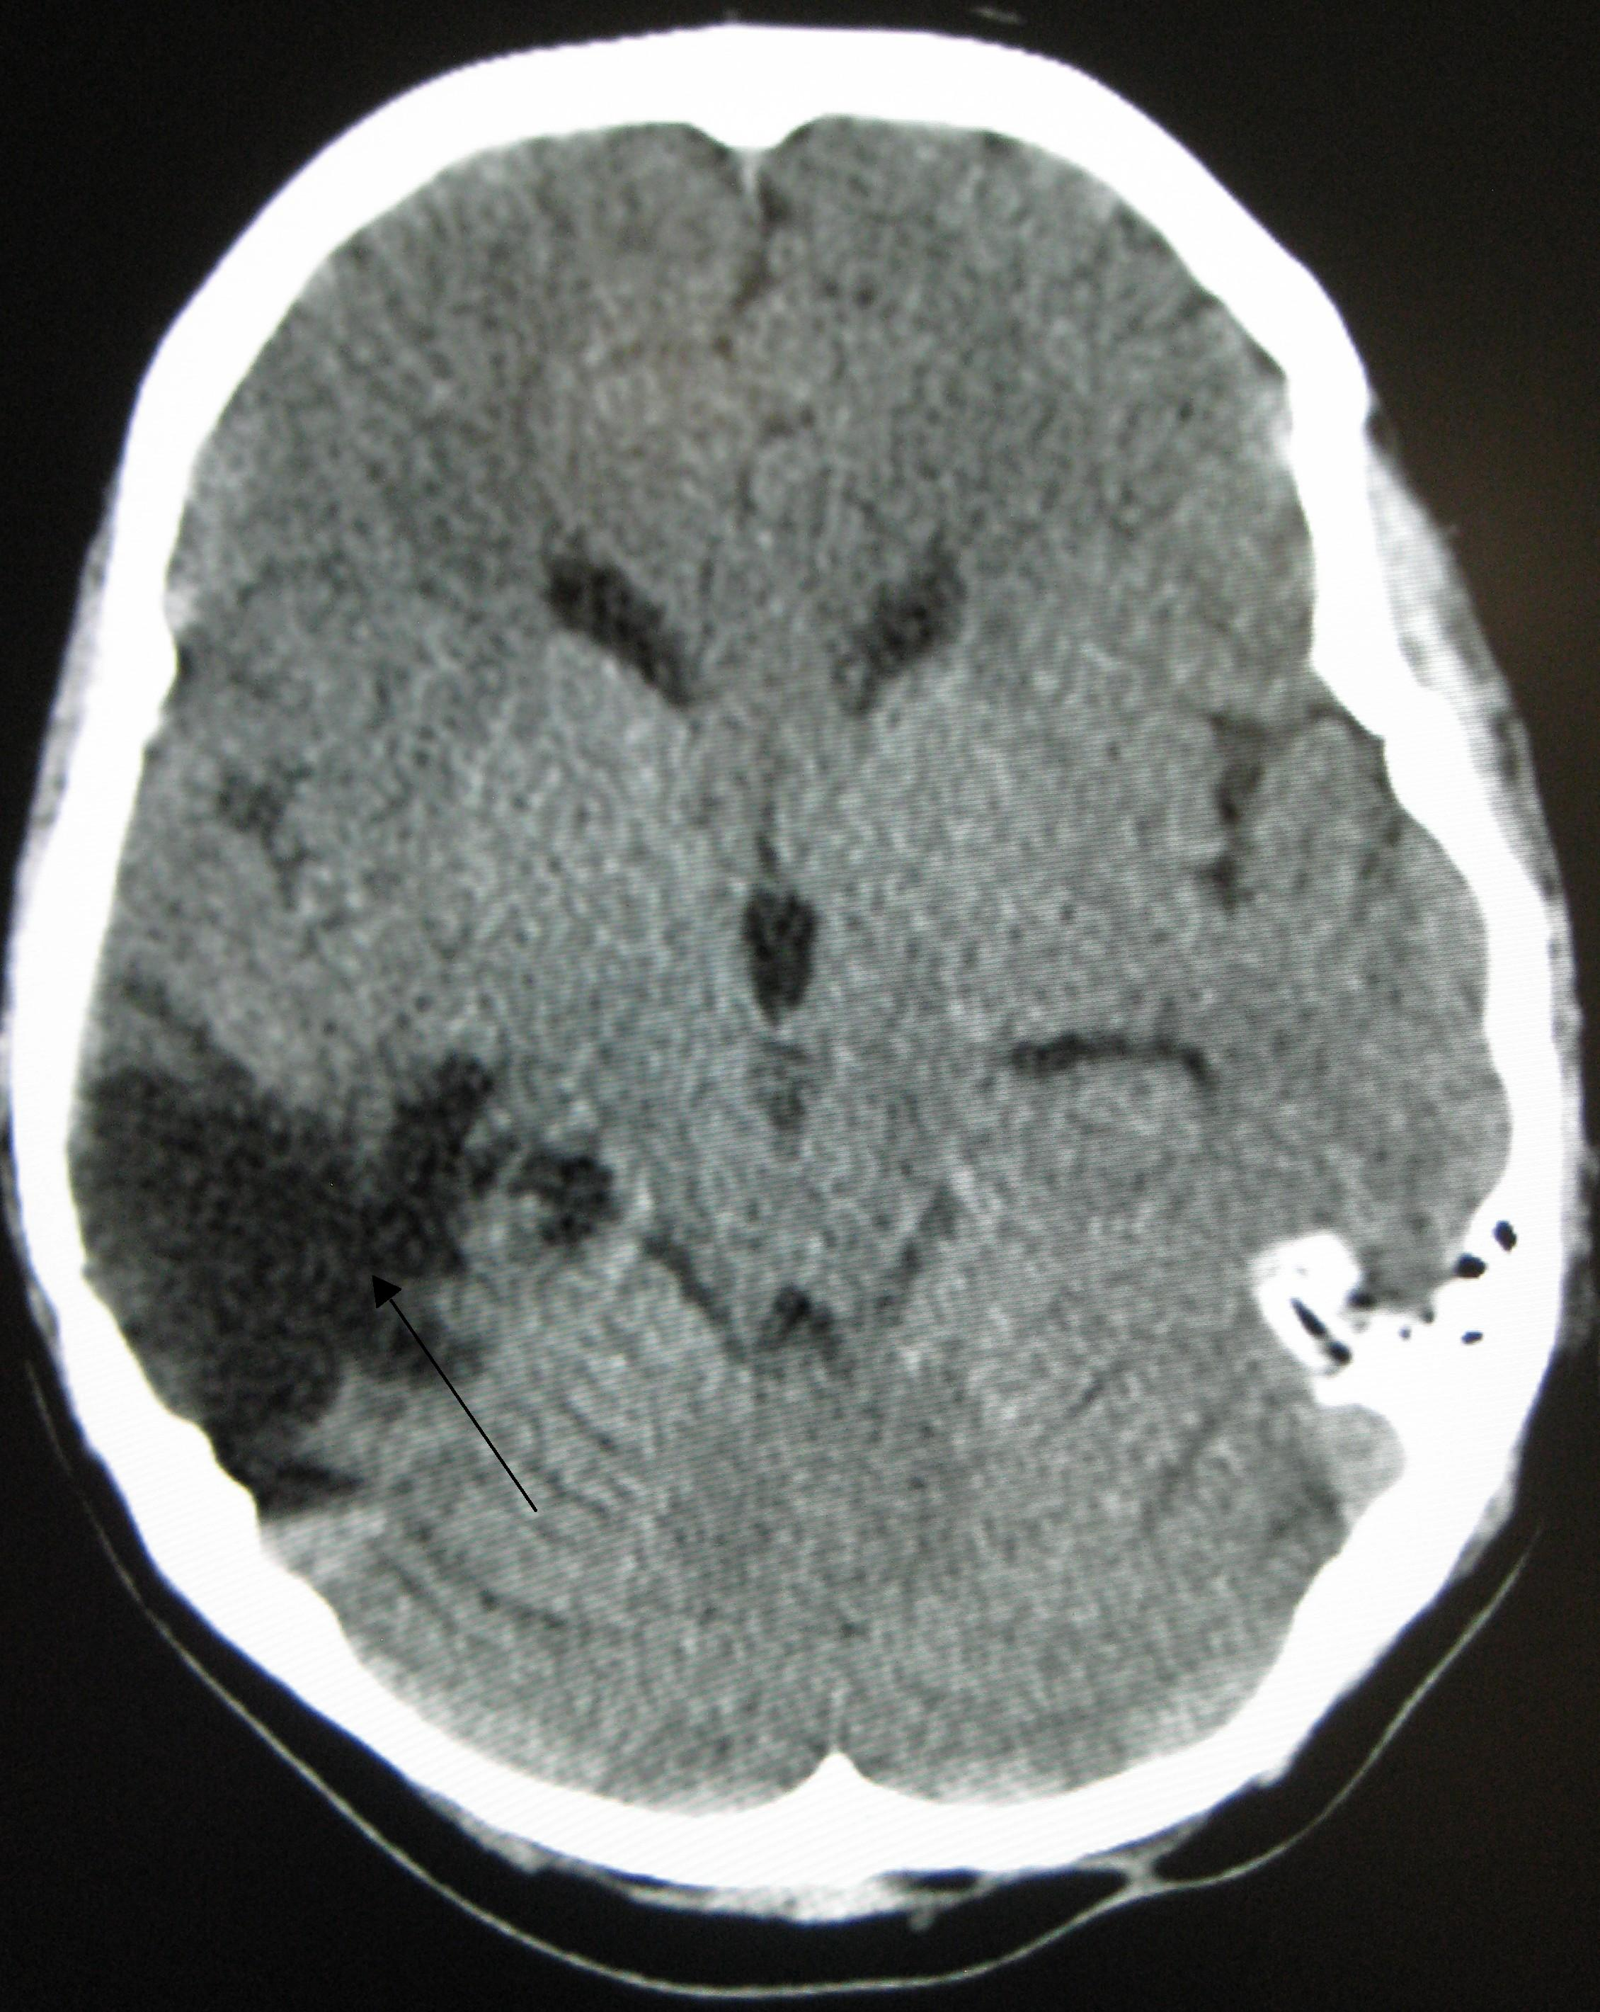


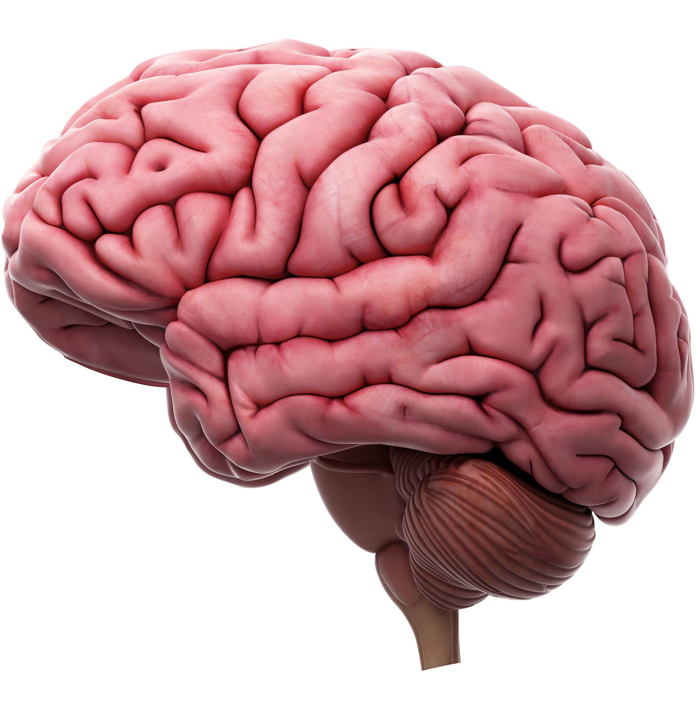
Repeated Use
Individual
Factors
Social
Influences
Medical
Brain
Damage
Mental Disorders
Social Problems
ADDICTION
Re-setting of Neurocircuits:
Rewards
Alertness
Salience
Behaviour Control
Driving Force of Substance Dependence

Slide 16
Natural Rewards Elevate Dopamine Levels
FOOD
SEX
200
200
NAc shell
150
150
DA Concentration (% Baseline)
100
100
% of Basal DA Output
15
Empty
10
50
Box
Feeding
Copulation Frequency
5
0
0
0
60
120
180
Female Present
Time (min)
Sample
Number
1
2
3
4
5
6
7
8
Mounts
Intromissions
Ejaculations
Di Chiara et al., Neuroscience, 1999.
Fiorino and Phillips, J. Neuroscience, 1997.

Slide 17
Effects of Drugs on Dopamine Release
AMPHETAMINE
COCAINE
1100
Accumbens
Accumbens
1000
400
900
800
DA
300
DA
700
DOPAC
DOPAC
% of Basal Release
HVA
HVA
600
% of Basal Release
500
200
400
300
200
100
100
0
0
0
1
2
3
4
5 hr
0
1
2
3
4
5 hr
Time After Amphetamine
Time After Cocaine
250
NICOTINE
MORPHINE
250
Accumbens
Dose (mg/kg)
200
Accumbens
200
0.5
Caudate
1.0
% of Basal Release
2.5
150
% of Basal Release
10
150
100
100
0
0
0
1
2
3 hr
0
1
2
3
4
5hr
Time After Nicotine
Time After Morphine
Di Chiara and Imperato, PNAS, 1988

Slide 18
Specific substances
Main focus:
Opioids
Methamphetamine
Whatever you want

Slide 19

Opioid overdose
Opioid intoxication:
Contracted pupils
Sedation
Low blood pressure
Slowed pulse
Respiratory depression (<12/min)
Slurred speech
Possibly: hypothermia, seizures

Slide 20
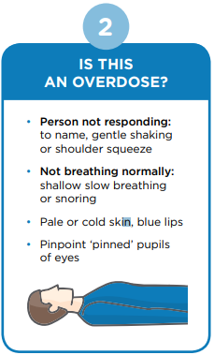
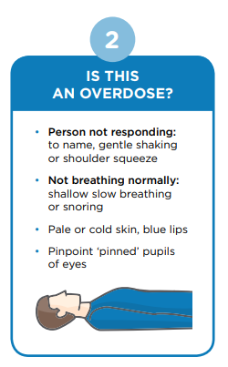
Opioid overdose
Naloxone is a fast-acting drug that reverses opioid overdose and prevents death. It can be given by injection or by a spray in the nose.
Use of take-home naloxone fits within harm-reduction strategies and patient-centred care. Naloxone is safe, effective, inexpensive and relatively easy to administer.
Administration can induce withdrawals in dependent patients.
Offer take-home naloxone to patients at increased risk of opioid overdose and family members or carers who are likely to witness opioid overdose.

Slide 21
Opioid withdrawals
Manifested by either of the following:
the characteristic opioid withdrawal syndrome
the same (or a closely related) substance are taken to relieve or avoid withdrawal symptoms

Slide 22
Withdrawals
Clinical Opioid Withdrawal Scale (COWS)
Tachycardia
Sweating
Restlessness
Dilated pupils
Myalgia (bone/joint aches)
Runny nose/watery eyes
Gastrointestinal upset
Stomach cramps
Nausea/vomiting/diarrhoea
Tremor
Yawning
Anxiety/irritability
Piloerection (goosebumps)
Subjective Opioid Withdrawal Scale (SOWS)
I feel anxious/irritable
I am sweating/perspiring
I am shaking
I have hot flashes
I have cold flushes
My bones and muscles ache
I feel restless
I feel nauseous
I feel like vomiting
My muscles twitch
I have stomach cramps
I feel like taking medication now
Opioid withdrawal symptoms generally start 6-24 hours after stopping use.
Symptoms reach their peak between days 1-3 of withdrawal, and start to improve after day 5.

Slide 23
Treatment options
Tapering and detoxification
Home
Residential
Hospital
Maintenance pharmacotherapy
Methadone
Buprenorphine

Slide 24
Why consider MATOD
Contraindications
Decompensated liver disease – may precipitate hepatic encephalopathy
Acute asthma or respiratory insufficiency
Cautions:
High-risk multiple substance use
Severe mental illness
Low levels of neuroadaptation to opioids
Significant co-existing medical problems
Reduction/cessation of illicit opioid use
Reduction/cessation of injecting and the associated risk of blood-borne virus
Reduction of overdose risk
Reduction of substance-related criminal activity
Support recovery
Risks
Diversion – high street value – methadone $1 per mg
Injecting drug use
Overdose – particularly if combined with other CNS depressants (alcohol, BZD, opiates)

Slide 25
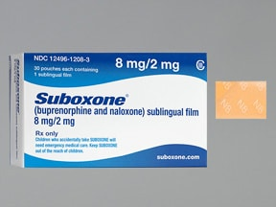
Buprenorphine
Mu-opioid receptor partial agonist resulting in competitive antagonism of concomitantly administered opioids
Peak plasma levels 3 hours
Terminal half-life 30 hours
Generally preferred to methadone due to the lower risks of sedation and respiratory depression and inclusion of naloxone.
Should wait until early withdrawal symptoms start before taking first dose (12-18 hours for short acting and 24-48 hours for long-acting).
Regardless of previous use, start between 4-8mg and can be increased gradually up to 32mg until cravings are managed. Typical dose is 8-16mg.

Slide 26
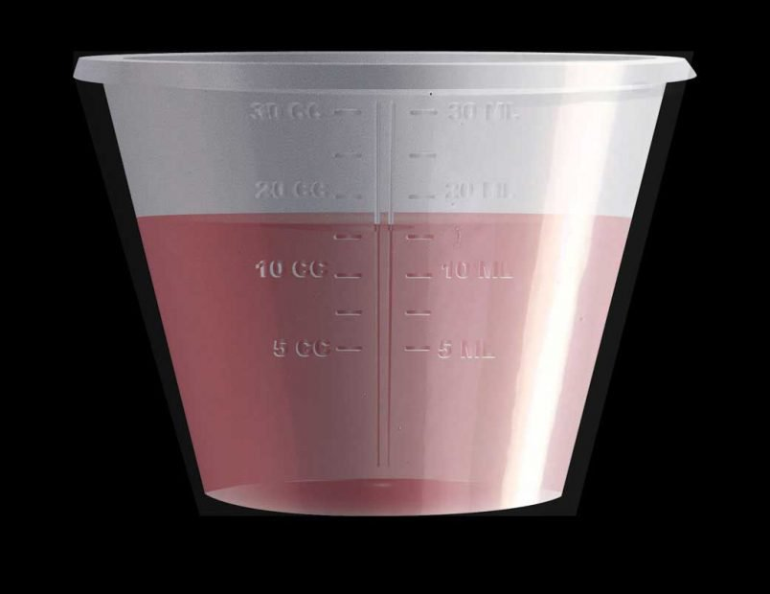
Methadone
Long-acting mu-opioid receptor preventing withdrawal symptoms for 24 hours or longer and reduces opioid cravings.
Given as a colour liquid at local pharmacy. Associated with many drug interactions and QTc prolongation.
Starting dose of 20 or 40mg
4 days to reach steady state
5-10mg increments every 3-5 days
Expected therapeutic range 60-120mg with involvement of addiction specialists at higher levels

Slide 27
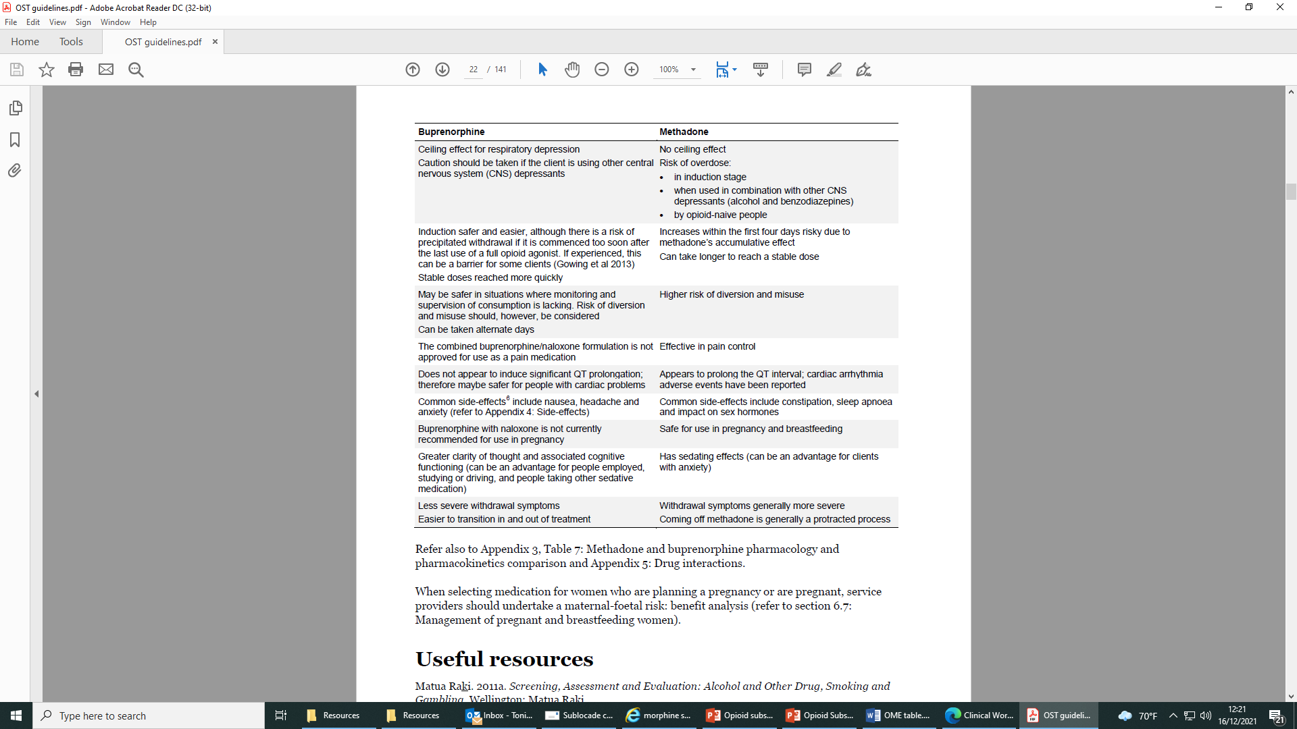
Use compared

Slide 28
Long-acting injectable Buprenorphine (LAIB)
Can be used after 7 days of trans mucosal use
Extended-release subcutaneous injection (XR; 30-day)
Weekly or monthly injectable formulation that can be used without a period of transmucosal stabilization

Slide 29
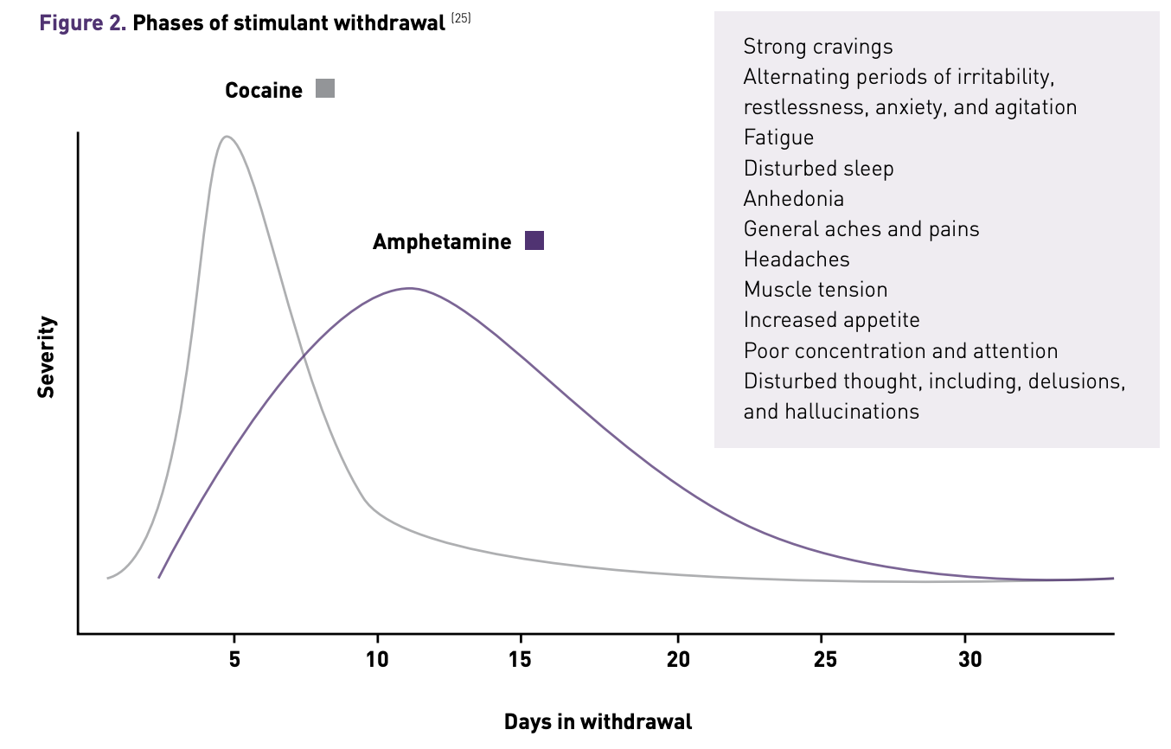
What are the challenges in treating methamphetamine use disorder?
Methamphetamine withdrawal takes longer than many other substances (10—15 days)
Grigg J., Manning V., Arunogiri S. et al. (2018). Methamphetamine Treatment Guidelines: Practice Guidelines for Health Professionals (Second Edition). Richmond, Victoria: Turning Point.

Slide 30
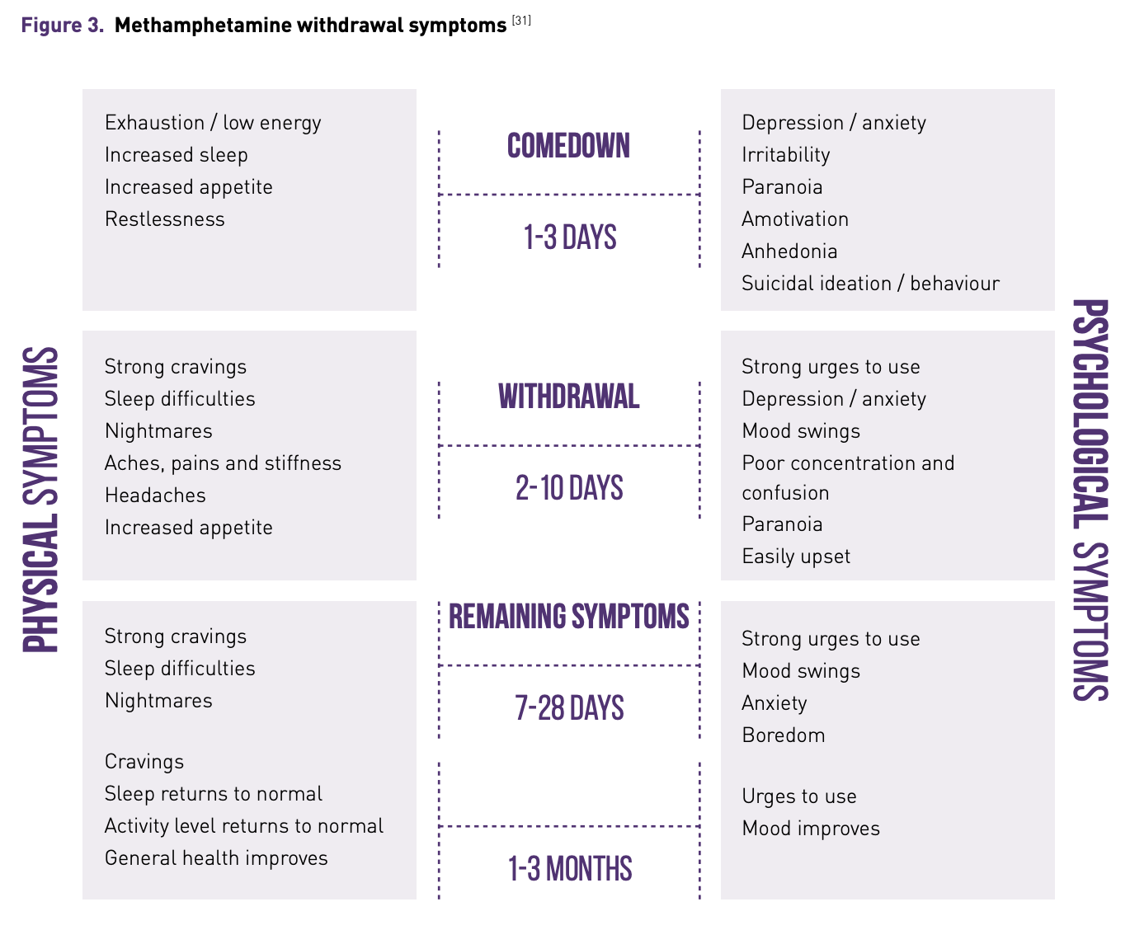
What are the challenges in treating methamphetamine use disorder?
Methamphetamine withdrawal takes longer than many other substances (10—15 days)
Grigg J., Manning V., Arunogiri S. et al. (2018). Methamphetamine Treatment Guidelines: Practice Guidelines for Health Professionals (Second Edition). Richmond, Victoria: Turning Point.

Slide 31
What are the challenges in treating methamphetamine use disorder?
Cravings for methamphetamine can last from 5 weeks to 3 months after stopping use
Grigg J., Manning V., Arunogiri S. et al. (2018). Methamphetamine Treatment Guidelines: Practice Guidelines for Health Professionals (Second Edition). Richmond, Victoria: Turning Point.

Slide 32
Other drugs we could discuss
Alcohol
Benzodiazepines
GHB
Nicotine

Slide 33
Local services
AODITT
Rollout of Hep C testing
Withdrawal pathways
Withdrawal support
SCHS
Counselling
NSP and Naloxone
Guidelines
MATOD only
(work in progress)
Notes:
MDAS, Mallee Family Care etc.

Slide 34
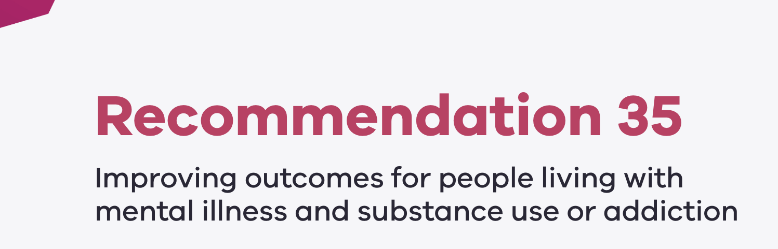
Background
”The Royal Commission recommended that all mental health and wellbeing services across all age-based systems, including crisis services, community based services and bed-based services:
provide integrated treatment, care and support to people living with mental illness and substance use or addiction
do not exclude consumers living with substance use or addiction from accessing treatment, care and support.”

Slide 35
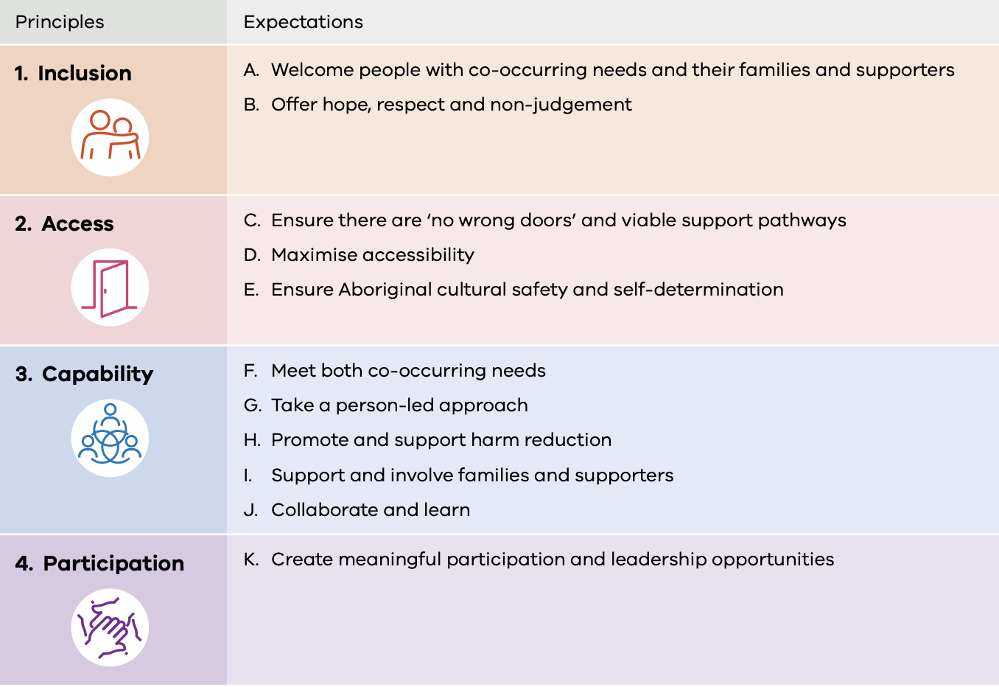
Overarching principles

Slide 36
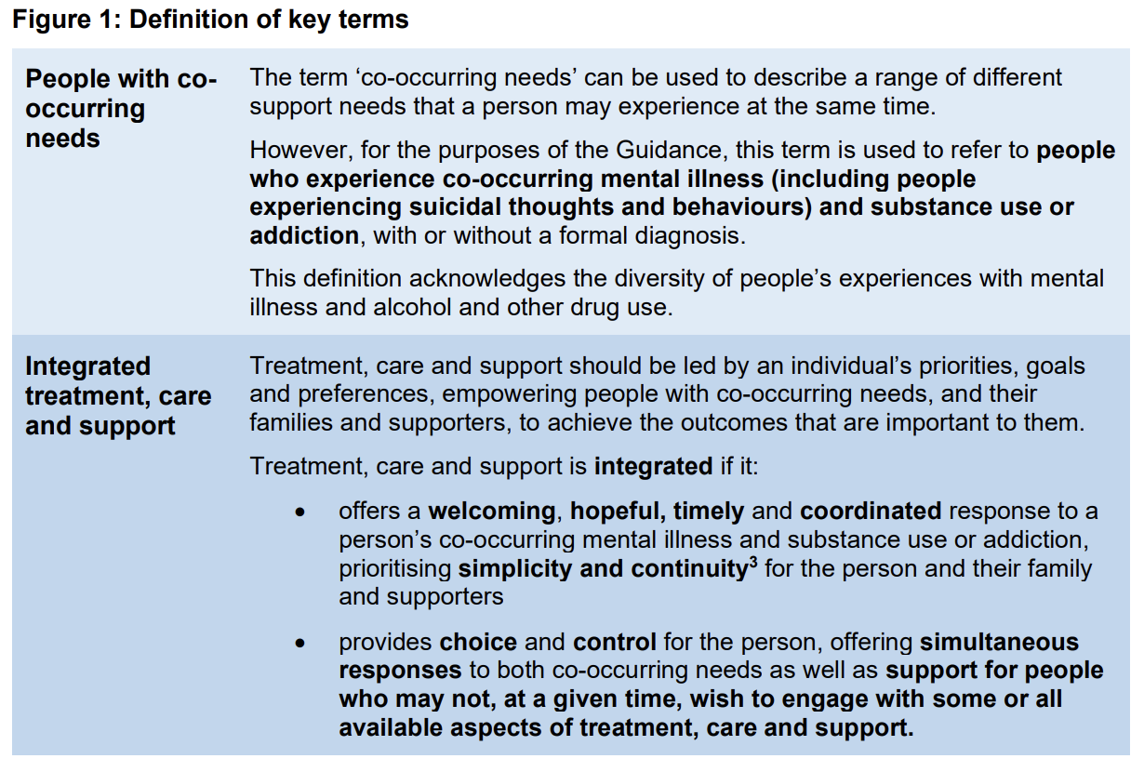
Overarching principles

Slide 37

Alcohol and Other Drugs Integrated Treatment Team

Slide 38
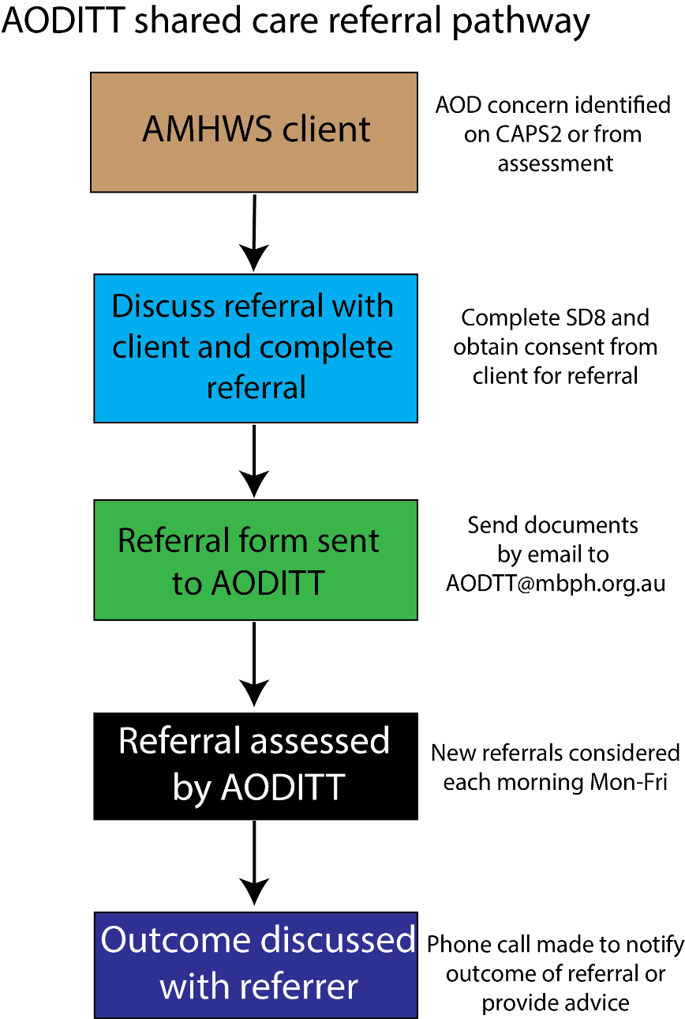
Current setup
Patients:
Should require tertiary level mental health care (high intensity/level 5) and meet criteria for one or multiple substance use disorders
Should be aged 12 or above at time of referral
Will be treated under a shared care arrangement

Slide 39
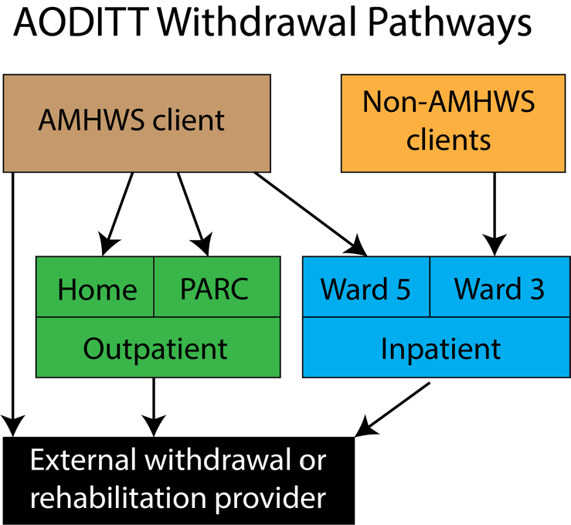
Current setup
Services provided:
Primary and secondary consultations
Harm reduction services
Inpatient / Outpatient withdrawal support
Pharmacotherapy
External referrals
Education and research

Slide 40
Current setup
Notes:
100 referrals in first four months
May 19
April 36
March 18
Feb 27

Slide 41
Current setup
Diagnoses | Trial period (n=64, %) | Since start (n=100, %)
Schizophrenia | 23 (35.9) | 26 (26)
Suicidal ideation | 10 (15.6) | 18 (18)
Depression | 8 (12.5) | 15 (15)
Personality disorder | 5 (7.8) | 6 (6)
Substance use disorder | 5 (7.8) | 8 (8)
PTSD | 3 (4.7) | 5 (5)
Psychosis | 3 (4.7) | 12 (12)
ADHD | 3 (4.7) | 3 (3)
Anxiety disorder | 4 (6.3) | 7 (7)
Bipolar disorder | - | 1 (1)

Slide 42
Current setup

Slide 43
Current setup
Substances of concern | Trial period (n=64, %) | Since start (n=100, %)
Alcohol | 15 (23.4) | 33 (32)
Cannabis | 15 (23.4) | 16 (16)
Stimulants | 14 (21.9) | 32 (32)
Opioids | 12 (18.8) | 12 (12)
Nicotine | 7 (10.9) | 3 (3)
Benzodiazepines | 1 (1.6) | 4 (4)

Slide 44
Current setup

Slide 45
Further developments
Expanding the team
MATOD
Wider hospital services (CL) and consistent withdrawal pathways
Primary Care involvement
Integrated specialist clinics
Regional Research Network
EDNAV
Hep C
Notes:
Additional registrar + advanced training + peer work
Consistent withdrawal pathways

Slide 46
Resources
DACAS
WADS
Turning Point Guidelines
Hamilton Centre

Slide 47
Where to get advice
z
RACGP MATOD training
Turning Point Guidelines
Alcohol and Drug Foundation
UpToDate
Vic Pharmacotherapy Policy
DACAS Factsheets
Dopesick on Disney+

Slide 48
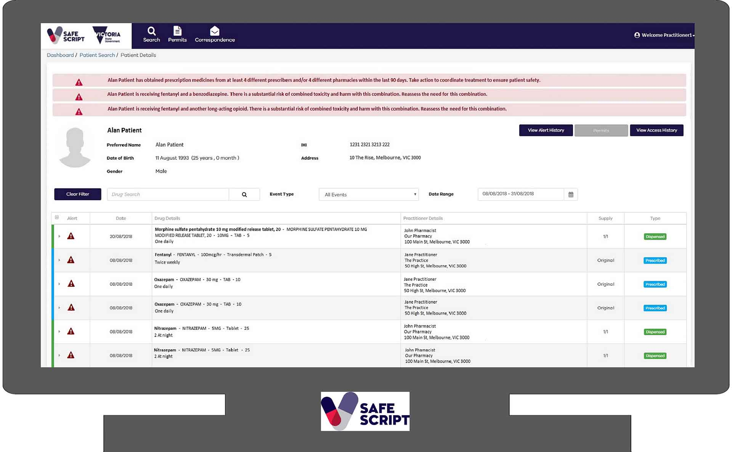

Slide 49
