Slide 1
What is anxiety
Normal / Abnormal
Unpleasant emotional state
Subjective fear
Bodily discomfort
Cluster of physical symptoms

Slide 2
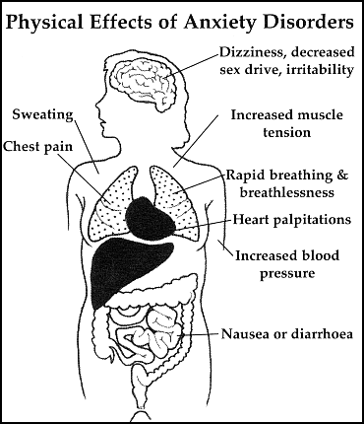
What is anxiety
Mental state symptoms
Losing control
Going crazy/passing out
Depersonalization
Derealization

Slide 3
Cluster of anxiety symptoms
Chest and abdomen
Breathing difficulties
Asphyxiate feeling
Pain in chest
Nauseas
Autonomic
Palpitation
Sweating
Trembling
Dry mouth
Mental state
Dizziness, faintness
Derealisation/depersonalization
Fear of losing control
Fear of dying
General symptoms
Hot flushes /shivering
numbness
Muscular tense
Restlessness
Choking
Other non-specific symptoms
Overreaction to surprises
Difficulty to concentrate
Persistent irritability
Insomnia

Slide 4
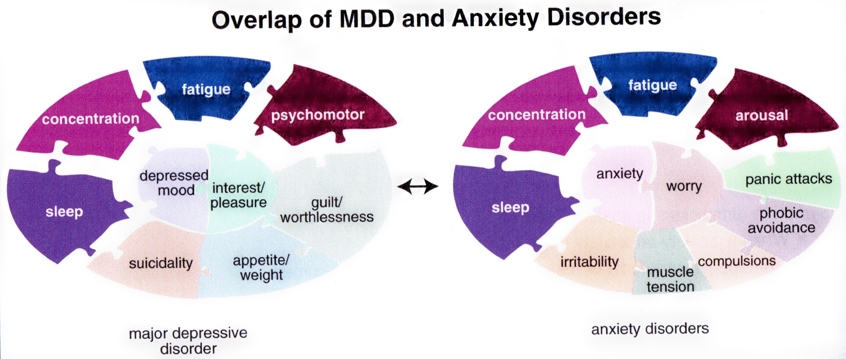

Slide 5
Cognitive Distortion
Dichotomous thinking
Overgeneralization:
Mental filter:
Disqualifying the positive
Jumping to conclusions
Mind reading
The Fortune Teller Error
Magnification (catastrophizing) or minimization
Emotional reasoning
Should statements
Labeling and mislabeling
Personalization

Slide 6
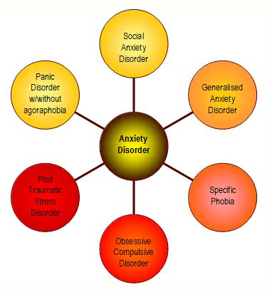
Classification of anxiety disorders

Slide 7
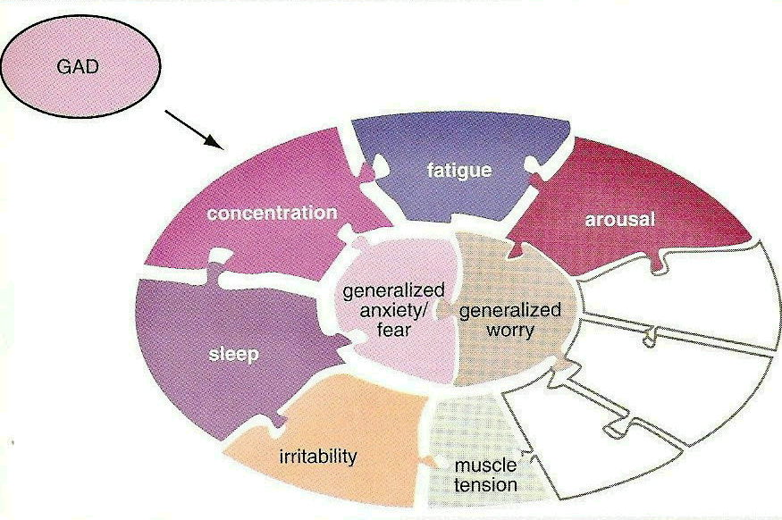

Slide 8
Generalized Anxiety Disorder (GAD)
Essential features are excessive worries about a number of events, activities or situations
Must be associated with some physical manifestations:
Restlessness or feeling “on edge”
Easily fatigued
Muscle tension
Usually some mood manifestations like irritability
Usually some sleep disturbance
Excessive worry impairs ability to perform tasks quickly and efficiently

Slide 9
Generalized Anxiety Disorder
Can occur early in childhood, usually described as an anxious, “perfectionistic” temperament
Children and adolescents with GAD often require excessive reassurance about situations or events and need more encouragement to participate in new activities

Slide 10
Screening for GAD
Establish baseline anxiety:
When you were in elementary or high school, did anxiety or worry affect your functioning?
School attendance
Making friends
Participating in activities or class
Somatic complaints
How would your friends have described you back then?

Slide 11
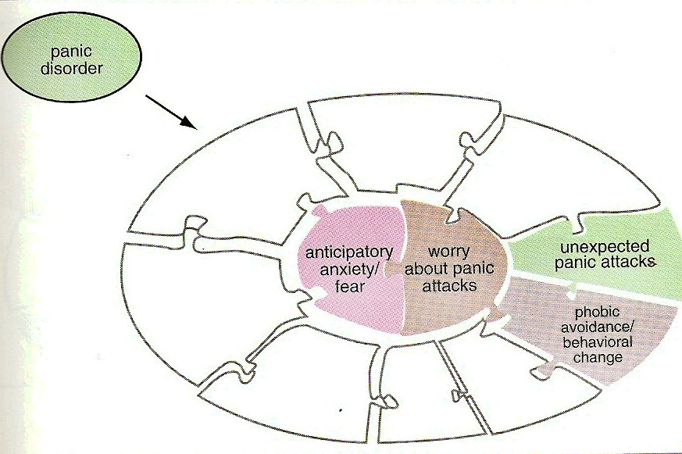

Slide 12
Panic Disorder
Recurrent and unexpected panic attacks
Abrupt surge of intense fear or discomfort which reaches a peak within minutes
Palpitations/increased heart rate
Sweating
Shaking
Shortness of breath, choking
Chest pain
Nausea
And at least one attack has been followed by 1 month of one/both of the following:
Persistent worry about additional attacks or their consequences (going crazy, having a heart attack)
Maladaptive change in behavior (avoidance)

Slide 13
Panic Disorder
Specify if Panic Disorder with Agoraphobia:
Marked fear or anxiety about 2 or more:
Using public transportation
Being in open spaces (parking lot, bridge)
Enclosed places (theatre, shops)
Standing in line, crowds
Being outside of the home alone
Individual fears or avoids these situations because of thoughts that escape might be difficult or help might not be readily available if they had a panic attack

Slide 14
Panic Disorder
In Panic Disorder, attacks are episodic
Abrupt surge of intense fear or discomfort
Unexpected – no obvious cue or trigger, occurs from out of the blue
The determination of whether panic attacks are expected or unexpected is made by the clinician by obtaining a history of events preceding the attacks
Can be difficult to distinguish between PTSD flashbacks and panic attacks
Similarly for panic attacks in the context of Social Anxiety Disorder (are attacks unexpected or triggered by being in social situations)

Slide 15
Panic Disorder
Common medical conditions are associated with panic like symptoms:
Endocrine conditions (thyroid, hyperadrenalism, pheochromocytoma, hyperparathyroid)
Drug intoxication/withdrawal
Cardiovascular (heart failure, arrhythmia, angina)
Respiratory (COPD, pulmonary embolism)
Metabolic (acidosis)
Electrolyte abnormalities (hypercalcemia)
Neurological (seizures)

Slide 16
Panic Disorder
Clinical clues to help differentiate organic vs primary panic disorder:
Onset of symptoms after age 35
Lack of personal or family history
Lack of a childhood history of significant anxiety
Absence of significant life events
Lack of avoidance behavior

Slide 17
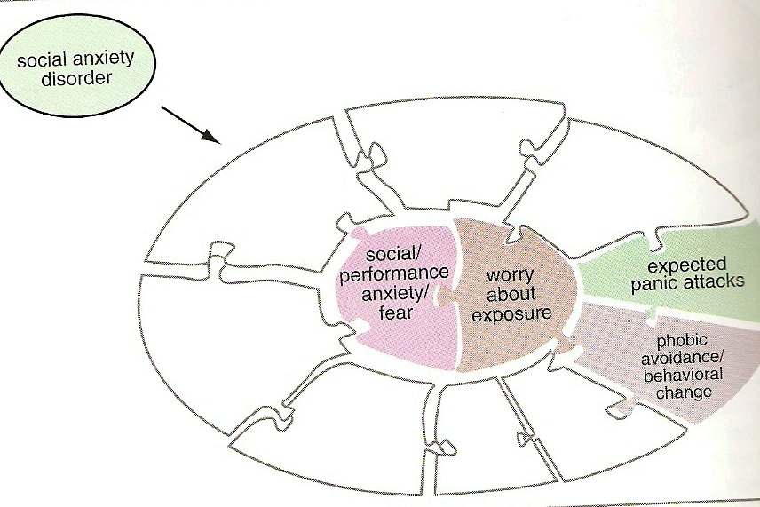

Slide 18
Social Anxiety Disorder
Marked intensity or fear of social situations in which the person is exposed to possible scrutiny by others
Fears that they will embarrass or humiliate themselves in public situations
Social situations are avoided or endured with intense fear or anxiety
Fear is out of proportion to the actual threat of the situation

Slide 19
Social Anxiety Disorder
In children anxiety may be expressed by tantrums, crying, freezing, clinging or not speaking in social situations
75% of individuals have an onset between ages 8-15 years old
First onset in adulthood is relatively rare

Slide 20
Social Anxiety Disorder
May be difficult to differentiate from:
Normative shyness (assess functional impairment)
Panic Disorder (agoraphobia vs fear of social evaluation)
Major Depression (negative cognitive schema)
Avoidant Personality Disorder

Slide 21
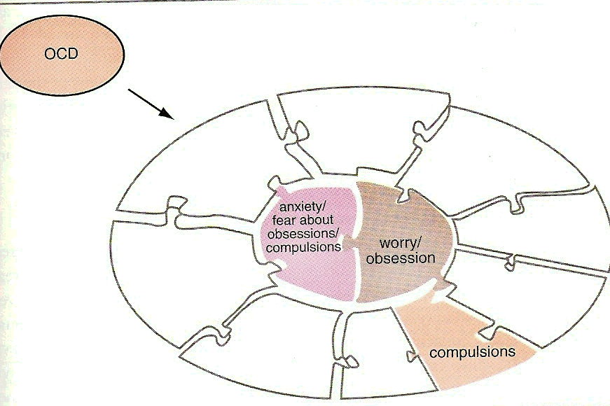

Slide 22
Obsessive compulsive disorder
Presentation:
Recurrent obsessional thoughts or compulsive acts
Distressing thoughts, patient unsuccessfully tries to resist them.
Recognized as own thoughts
Compulsive acts not enjoyable
Acts fxn to prevent some unlikely event, often involving harm to or caused by the patient, which he or she fears might otherwise occur.
Notes:
These recurrent thoughts could be ideas, images, or impulses.
These compulsive acts could be stereotyped behaviors that are repeated again and again.
Talk about dermatologist in the USA who was suicidal due to concerns she may have infected patients with hepatitis

Slide 23
Obsessive compulsive disorder
Aetiology:
Genetics
Associated with brain disorders e.g. obsessions in Tourettes, OCD in Sydenham’s chorea & PANDAS
Fxnal ab(n) in the brain: ↑ activity in OFC,ACC, Caudate and Thalamus
Ab (n) 5HT fxn
Epidemiology
Gender Ratio ♀:♂ 1.5:1
Annual prevalence: 1%
Lifetime prevalence: 2-3
Affects approx 750k in the UK (30-40k in Wales)
Course of the illness: 2/3 improve within 1 yr, 1/3 fluctuating or chronic
Prognosis: worse if childhood onset
Notes:
PANDAS- paediatric autoimmune neuropsychiatric disorder associated with streptococcal infections: Grp A strept infxns.
OFC- orbitofrontal cortex
ACC- anterior cingulate cortex

Slide 24
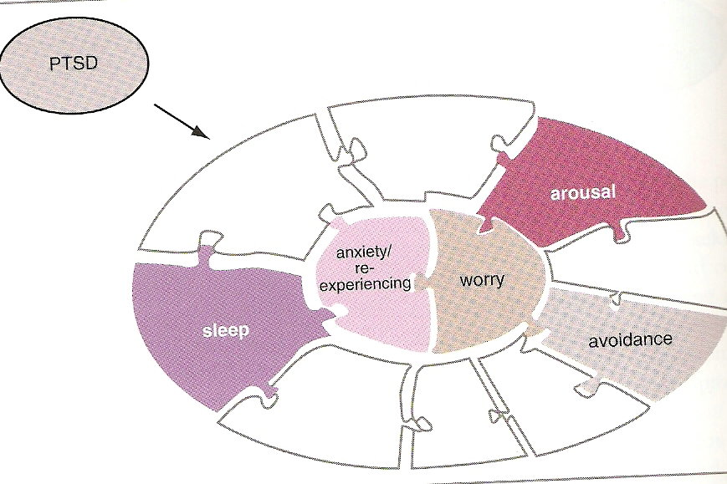

Slide 25
Post-traumatic stress disorder
Presentation
Intense, prolonged response to an exceptionally threatening event or situation e.g. RTA, Rape, War
Intrusions
Flashbacks, Intense imagery, recurrent distressing dreams
Avoidance
Difficulty recalling event at will, avoidance of reminders, detachment, numbness, reduced interests
Hyperarousal
Persistent anxiety, irritability, insomnia, poor concentration
Notes:
Post-traumatic stress disorder would present as an intense, prolonged response to an exceptionally threatening event or situation e.g. RTA, Rape, War.
Typically the features involve CLICK
Intrusions
Flashbacks, Intense imagery, recurrent distressing dreams
CLICK
Avoidance
Difficulty recalling event at will, avoidance of reminders, detachment, numbness, reduced interests
CLICK
Hyperarousal
Persistent anxiety, irritability, insomnia, poor concentration
Pre-morbid personality plays a role in this as not every one who is involved in the event will have PTSD: Talk about the ship sinking that not everyone had PTSD
Usually the symptoms of PTSD begin soon after the stressful event but occasionally this may be delayed but rarely longer than 6 months after the event.
The symptoms have to be present for at least 1 month and would usually cause significant distress or impaired social functioning
Talk about soldier in the troubles who assaulted Irish speaking man in Wales because he had a flashback
Talk about the boy who avoided driving after he had an accident that his friend died in

Slide 26
Post-traumatic stress disorder
Epidemiology
Gender Ratio ♀:♂ 2:1
Annual prevalence: 1%
Lifetime prevalence: 7-8%
Course of illness: 50% will recover, 50% will go on to develop chronic PTSD
Co-morbidity: substance misuse, depression

Slide 27
Aetiology of anxiety disorders
Biological
Psycho-social
Predisposing
Familial
-Complex, polygenic
-Candidate genes include:
5HT Transporter
BDNF
-Cognitive - behavioural model
Underestimate coping
Overestimate risk
-Childhood trauma
-Anxious / dependent traits
Neuroticism
-Parenting
-Unconscious conflict (Freud)‏
-“Preparedness” (Seligman)‏
Precipitating
-Physical illness (Panic)‏
-Life events (Panic / GAD)‏
Perpetuating
-Comorbidity (phys / mental)‏
-Substance misuse
-Avoidance
-Family / friends colluding
-Social isolation

Slide 28
Differential Diagnosis (Anxiety Disorders)‏
Endocrine
Hyperthyroidism
Hypoparathyroidism
Hypoglycaemia
Phaeochromocytoma
Carcinoid syndrome
Cushing’s disease
CVS
Arrhythmias
Mitral valve prolapse
Neurological
Seizures
Vestibular disease
Respiratory
COPD / Asthma
Haematological
Anaemia
Substances
Stimulants
Theophylline
Alcohol / sedative withdrawal
Notes:
What would you want to exclude?
Phaeochromocytoma = adrenal tumour

Slide 29
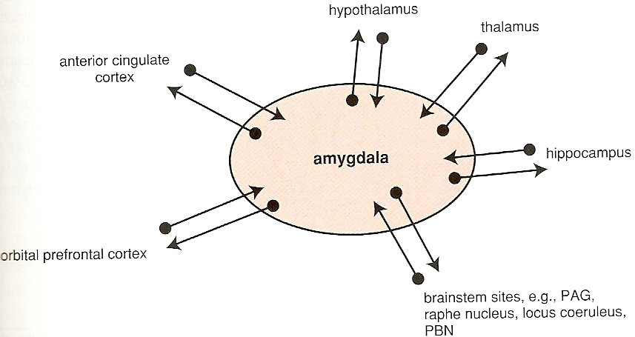
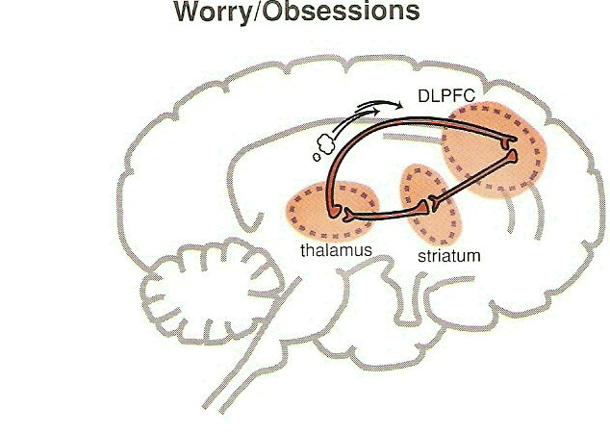
Fear

Slide 30
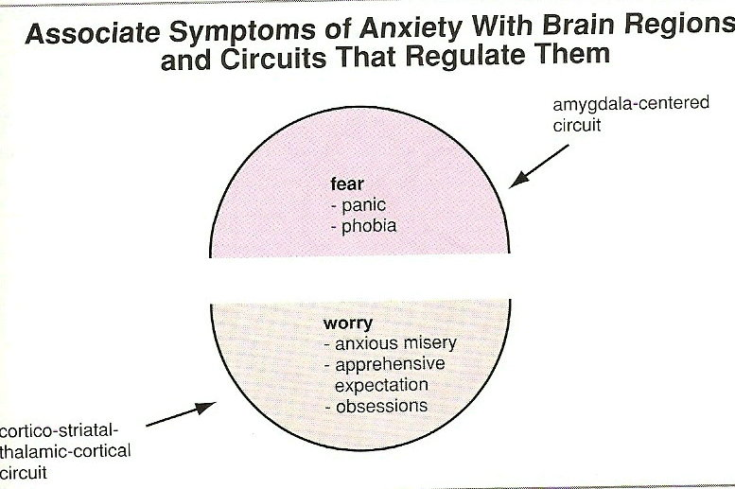
Neuroanatomy of anxiety

Slide 31

Treatment
Bio
Antidepressants
Anxiolytics
Psycho
CBT
Social

Slide 32
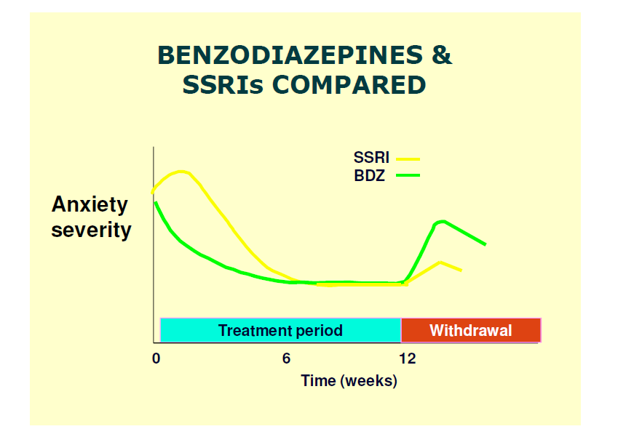
Anxiety
Agitation
Irritability
Slide adapted from Dr. Simon Davies

Slide 33
CBT
“Here and now therapy”
Fixed number of sessions, which is subsequently reviewed
Change maladaptive thinking patterns in order to change
emotions & behaviours: exaggeration of risk, minimisation of capacity
to cope
Thoughts are opinions and subject to debate
Techniques
Diary keeping (thought / behaviour / emotion)‏
Discuss evidence for / against thoughts
Behavioural experiments to test hypotheses

Slide 34
Antidepressants
Tricyclic and related antidepressants (TCA)
E.g. amitriptyline, imipramine, doxepin, mianserin, trazodone
Older generation have lots of side effects
Monoamine-oxidase inhibitors (MAOI)
E.g. moclobemide, phenelzine, isocarboxazid, tranylcypromine
Dietary restrictions so rarely used now
Selective serotonin reuptake inhibitors (SSRI)
E.g. fluoxetine, paroxetine, sertraline, citalopram
Other antidepressants (many are “dual action”)
E.g. mirtazapine, venlafaxine, duloxetine

Slide 35
Anxiolytic drugs
Benzodiazepines “GABA”
Buspirone “5HT”
Other drugs used as anxiolytics
Beta-Blocker drugs (Propanolol) “NE”
Alpha2-agonist drugs (Clonidine) “NE”
Antipsychotic in low doses (Olanzapine)
Anti histaminic drugs (Hydroxycine)
Antidepressant (ATD)

Slide 36
Types of Benzodiazepines
Anxiolytic | Antiepileptic | Hypnotic | Anaesthetic
Chlordiazepoxide | Clonazepam | Nitrazepam | Midazolam
Diazepam | Diazepam | Lormetazepam
Bromazepam | Clobazam | Flunitrazepam
Oxazepam | Clorazepate | Temazepam
Clorazepate |  | Loprazolam
Clobazam |  | Estazolam
Alprazolam |  | Triazolam
Prazepam
Lorazepam

Slide 37
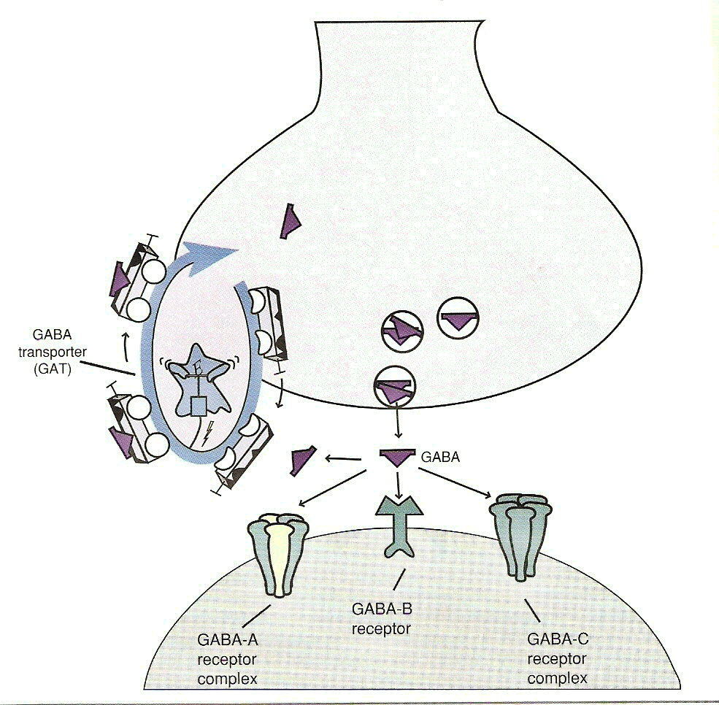
GABA transmission

Slide 38
Pharmacokinetic of BZ
Complete oral absorption
Strongly bound to plasma proteins
Lipophilic and pass readily into the brain
Hepatic metabolism: to large number of compounds
Many compounds have therapeutic effect on their own:
Diazepam → oxazepam, temazepam...
Excretion mainly as conjugates in urine

Slide 39
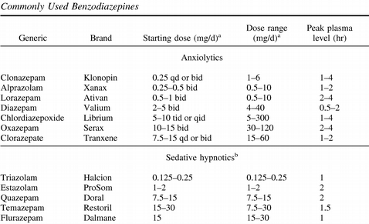

Slide 40
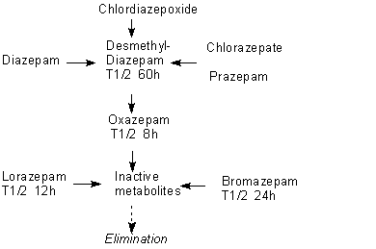
Metabolites of BZ

Slide 41
Main use of BZ
Anxiolytic: Anxiety disorders, alcohol withdrawal
Hypnotic: Sleep disorder
Anticonvulsant: Epilepsy, myoclonus, alcohol withdrawal
Muscle relaxant: Spasticity, akathisia
NICE recommend:
Not to use BZ in Panic Disorder
Use BZ very carefully in PSTD
Use BZ only max 4 weeks in GAD
Avoid use of BZ if history of substance misuse/PD
No evidence to use BZ in start ATD treatment
No evidence to use BZ alongside ATP treatment
Prodromal of psychosis (evidence)
Resistant psychosis treatment alongside ATP (alprazolam/clonazepam)

Slide 42
Side effects of BZ
Common | Occasional | Rare
Drowsiness Dizziness psychomotor impairment | Dry mouth blurred vision GI upset Headache Ataxia Dysarthria Paradoxical excitement Risk of falls and increased 50% risk of hip fracture, & confusion in elderly | Amnesia Restlessness Disinhibition Skin rash Eosinophilia Respiratory depression(with I.V. BZ)

Slide 43
Treatment of GAD
1st line
SSRI
VENLAFAXINE
TCA (imipramine, clomipramine)
2nd line
BUSPIRONE
BETABLOCKERS
HYDROXYCINE
PREGABALIN
GABAPENTIN
MIRTAZAPINE
And
+/- HYPNOTIC (max four weeks)
Reassurance
Anxiety management
CBT

Slide 44
Treatment of Panic Disorder
1st line
SSRI
2nd line
MAOIs
And
+/- HYPNOTIC (max four weeks)
CBT
TCA (imipramine, clomipramine)
Reboxetine
MIRTAZAPINE
VALPROATE
VENLAFAXINE
Anxiety management

Slide 45
Treatment of Social Phobias
1st line
SSRI
2nd line
BETA BLOCKER (propranolol)
And
+/- HYPNOTIC (max four weeks)
CBT
MAOIs
CLONAZEPAM
BUSPIRONE
VENLAFAXINE
VALPROATE
MIRTAZAPINE

Slide 46
Treatment of OCD
1st line
SSRI
2nd line
RISPERIDONE, QUETIAPINE
And
+/- HYPNOTIC (max four weeks)
CLOMIPRAMINE
VENLAFAXINE (not recommended
by NICE)
BUSPIRONE
CLOMIPRAMINE (IV)
CLONAZEPAM(max 4 weeks NICE)
MIRTAZAPINE Augmentation of SSRI
CITALOPRAM (Augmentation of
Clomipramine)
Behavioural therapy
CBT
Exposure therapy

Slide 47
Treatment of PTSD
1st line
SSRI
2nd line
MAOI
And
+/- HYPNOTIC (max four weeks)
Counselling
Serotonergic TCAs
VALPROATE
CARBAMAZEPINE
CLONIDINE
Risperidone, Olanzapine, Quetiapine
MIRTAZAPINE
PHENYTOIN
VENLAFAXINE
Anxiety management
CBT for avoidance, reexperiencing

Slide 48
Anxiety disorders Summary
Common (18% lifetime prev)‏
Multiple manifestations
Situation and nature of symptoms key to Dx
Can be chronic and disabling
Multifactorial aetiology (bio-psychosocial)‏
Comorbidity
Effective treatments
CBT
SSRIs
Notes:
Cf schizophrenia 1%
Aetiology - several factors genetic and stressful life events common

