Slide 1
Bias
The results of a study is said to have external validity (generalisability) if not compromised by:
Random error (chance)
Systematic error (bias)
Confounding
Random error – generally addressed via statistical testing and measurements (p-value, confidence intervals and increasing evidence base over time).
2. Bias – is generally introduced from study design through how we select cases, measure data or analyse results. These need to be identified and accounted for in process as much as possible.
3. Confounding – when results (magnitude of effect) are impacted by a third variable linked to both the outcome (dependent variable) and the independent variable studied.

Slide 2
Bias
Selection bias | Measurement bias | Analysis bias
Berkson bias Neyman bias Response bias Unmasking bias Lead-time bias Referral bias Diagnostic purity bias Membership bias | Recall bias Reporting bias Observer bias Surveillance bias Verification bias Misclassification bias Desirability bias Hawthorne effect | Contamination bias Availability bias Confirmation bias
Randomisation | Blinding | Intention to treat

Slide 3
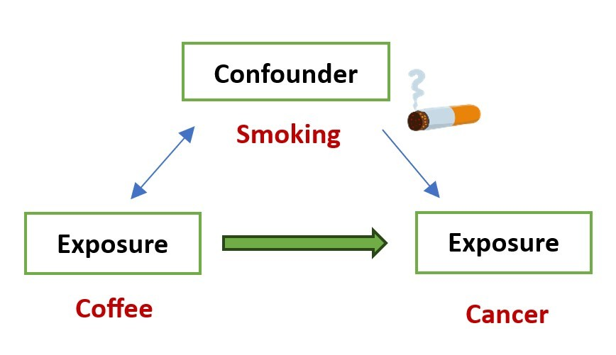
Confounder
The confounder must be related to the exposure
The confounder must be linked to the outcome
It must not be the causal pathway
Distribution must be different in the groups
Addressed via:
Stratification
Matching
Randomisation
Also: Effect modifiers

Slide 4
The study design was initially planned with the controls selected from lists of attendees at the medical services in the city. However, a senior epidemiologist recommended against this as it would lead to biased results. How could the recruitment of controls from medical services bias the study results?
A case-control study investigated moderate to high alcohol consumption as a risk factor for bowel cancer. To undertake the study, researchers first identified all new cases of bowel cancer in a small city through contact with the relevant medical services. Controls for the study were recruited using a random sample of community members from across all suburbs of the city. After recruitment, a total of 88 men and women aged 50 to 70 years with bowel cancer and 277 men and women aged 50 to 70 years without bowel cancer were enrolled. Participants were questioned about alcohol consumption over the preceding 10 years and were then classified as low/non-consumers or moderate/high consumers. The table below presents the findings after data collection.

Slide 5
After the study was completed, a follow-up study was conducted using previous medical records to ascertain alcohol consumption over the 10-year period for all participants. This investigation identified that, while for the cases alcohol consumption was reported accurately, for the control group 50% of participants had under-reported their alcohol consumption. What specific type of bias has occurred here?
A case-control study investigated moderate to high alcohol consumption as a risk factor for bowel cancer. To undertake the study, researchers first identified all new cases of bowel cancer in a small city through contact with the relevant medical services. Controls for the study were recruited using a random sample of community members from across all suburbs of the city. After recruitment, a total of 88 men and women aged 50 to 70 years with bowel cancer and 277 men and women aged 50 to 70 years without bowel cancer were enrolled. Participants were questioned about alcohol consumption over the preceding 10 years and were then classified as low/non-consumers or moderate/high consumers. The table below presents the findings after data collection.

Slide 6
What epidemiological problem has the type of bias in led to, with respect to measurement and analysis?
A case-control study investigated moderate to high alcohol consumption as a risk factor for bowel cancer. To undertake the study, researchers first identified all new cases of bowel cancer in a small city through contact with the relevant medical services. Controls for the study were recruited using a random sample of community members from across all suburbs of the city. After recruitment, a total of 88 men and women aged 50 to 70 years with bowel cancer and 277 men and women aged 50 to 70 years without bowel cancer were enrolled. Participants were questioned about alcohol consumption over the preceding 10 years and were then classified as low/non-consumers or moderate/high consumers. The table below presents the findings after data collection.

