Slide 1
Bipolar Affective Disorder
Dr Robert Lundin

Slide 2
How common is it?
12 month prevalence in the US: 1.5%
Lifetime prevalence in the US: 2.1%
Cross-sectional prevalence in primary care: 1.9%
Merikangas, 2007; Stubbs, 2016

Slide 3
What's the big deal?
People with bipolar disorder are more likely to have Treatment Resistant Depression (compared to MDD)
Does not respond to antidepressants
High risk of suicide:
12 month attempt prevalence: 1%
Lifetime attempt prevalence: 50%
Lifetime suicide mortality: 8%
High rates of substance use: 50%
Schaffer, 2014; Correa, 2010; Nordentoft, 2011; Bschor, 2012

Slide 4
Natural history and course
First episode usually depression
Can be followed by years of remission but recurrence is likely
Can have complete recovery between episodes
Residual depressive symptoms common
Rapid cycling in 13-20% (>4 episodes/year)
More common in women
More severe
Earlier onset
Antidepressants
Deliberate self harm or behaviours in up to 50%
Completed suicide in 15%

Slide 5
Natural history and course
Bipolar disorder tends to worsen if it is not treated
More frequent, more severe episodes
Delays in getting the correct diagnosis and treatment make a person more likely to experience personal, social, and work-related problems
Misprescribed antidepressants – rapid cycling

Slide 6
How do I screen* for it?
*None of these diagnose
Mood Disorder Questionnaire (MDQ)
Mental health center: sensitivity 66%, specificity 76%
Primary care center: sensitivity 43%, specificity 95%
Hypomania symptom checklist (HCL-32)
Mental health center: sensitivity 81%, specificity 67%
Bipolar spectrum diagnostic scale (BSDS)
Mental health center: sensitivity 69%, specificity 86%
Carvalho, 2015

Slide 7
How do I diagnose it?
A. Distinct period of abnormally and persistently elevated, expansive, or irritable mood and abnormally and persistently increased activity or energy, lasting at least 1 week and present most of the day, nearly every day, or requires hospitalization.
B. 3+ if expansive, 4+ if irritable:
Inflated self-esteem or grandiosity, decreased need for sleep, pressured speech, flight of ideas, distractibility, increased goal directed activity or psychomotor agitation, excessive involvement in activities with high potential for painful consequences
C. Mood disturbance is sufficiently severe to cause marked impairment in social or occupational functioning or require hospitalization
D. Not due to a substance
DSM 5, 2013

Slide 8
Situations confused with bipolar disorder
Stimulant misuse: euphoria, increased activity, harmful activity, decreased need for sleep, irritability, depression afterwards
Corticosteroid use: euphoria, increased activity, harmful activity, decreased need for sleep, depression afterwards
Thyroid disease
Stroke
TBI

Slide 9
Situations confused with bipolar disorder
Borderline personality disorder: mood lability, irritability, impulsivity, harmful behaviors
ADHD: distractibility, impulsivity, talkativeness
PTSD: irritability, reckless behavior, sleep disturbance
GAD: irritability, recklessness, sleep disturbance, racing thoughts

Slide 10
Diagnosing bipolar disorder (manic depressive illness): classification
Bipolar I
At least one manic episode
Causes impairment of functioning
Duration of 1 week
Bipolar II
At least one hypomanic episode
No severe impairment
Duration of 4 days

Slide 11
What does mania feel like?
‘When you’re high it’s tremendous. The ideas and feelings are fast and frequent ... Shyness goes, the right words and gestures are suddenly there, the power to captivate others a felt certainty ... Sensuality is pervasive and the desire to seduce and be seduced is irresistible’
Jamison, K. R. (1995) An Unquiet Mind: A Memoir of Moods and Madness. New York: Knopf.

Slide 12
Manic episode
Mood
motor activity
thinking
Elevated mood
Excitement
Irritability
Inappropriate
Very productive
Increased energy
Reduced sleep
Poor concentration
Over-familiarity
Increased interest in sex
Rapid speech
Flight of ideas
Clang associations
Punning
Rhyming
Grandiose ideas

Slide 13
DSM-IV criteria for a manic episode
One week elevated or irritable mood
Three or more:
grandiosity
decreased sleep
pressured speech
flight of ideas/racing thoughts
distractibility
activation or agitation
‘heedless pleasure’
Impaired functioning/hospitalisation

Slide 14
If mania feel so good, why treat it?
Risk of exploitation (financial, sexual)
Risk of confrontation
Debt and loss of job
Risk of psychosis
Swing in to severe depression (even with hypomania)
Mixed states – agitation with suicidal ideas

Slide 15
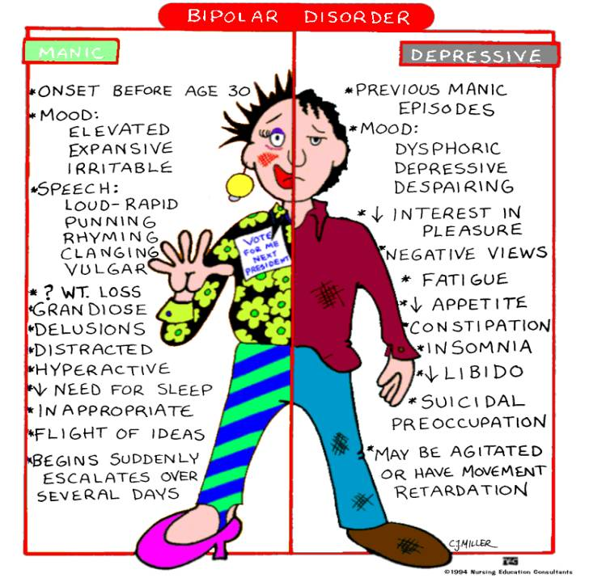
Bipolar disorder

Slide 16
Modern classification of Mood Disorders
Unipolar
single episode
‘Unipolar’
Unipolar
recurrent
Dysthymia
Bipolar I
‘Bipolar’
Bipolar II
Cyclothymia
Unipolar-
Hyperthymic

Slide 17
Bipolar affective disorder in ICD-10
Bipolar affective disorder:
current episode hypomanic
current episode manic +/- psychotic symptoms
current episode mild/moderate/severe depression (+/- psychotic symptoms)

Slide 18
Bipolar episode with psychotic symptoms
Sometimes wrongly diagnosed as having schizophrenia
Hallucinations and/or delusions
Usually mood congruent – grandiose or depressive (e.g. pathological guilt)
Persecutory delusions common
Formal thought disorder can occur

Slide 19
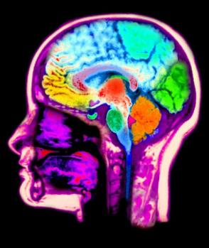
What causes bipolar disorder?
Strongly genetic component
Heritability estimates approach 0.9
Concordance in MZ twins of 50-70%
Early-onset bipolar disorder may be even more genetic
Multiple genes confer risk (polygenic model)
Environmental factors also important:
Early adversity or abuse, recent life events, drugs and alcohol, sleep deprivation.

Slide 20
What diseases co-exist with bipolar?
Substance abuse - alcohol or drugs.
Self medication
During mania (reckless/impulsive)
Substances can trigger illness/increase treatment resistance
Anxiety disorders, inc (PTSD) and social phobia
Attention deficit hyperactivity disorder (ADHD), which has some symptoms that overlap
Thyroid disease, migraine headaches, heart disease, diabetes, obesity, and other physical illnesses.^{10, 11}
These illnesses may cause symptoms of mania or depression.
They may also result from treatment for bipolar disorder.
Hypothyroidism increases risk of bipolar disorder

Slide 21
Treatment Goals and Targets in Bipolar Disorder
Goals:
Reduction in number and severity of episodes
Improved inter-episode functioning
Restoration of normal sleep patterns
Suicide prevention
Targets:
Acute mania
Acute depression
Maintenance phase

Slide 22
Management of mania
Admission to hospital often necessary
Sectioning under the Mental Health Act is common (poor insight)
Acute Treatment:
Antipsychotic drugs (part. mixed states)
Lithium
Benzodiazepines
Prophylactic treatment:
Mood stabilisers

Slide 23
Treatment Options for Bipolar Disorder
Pharmacological Treatment
Mood stabilizers
Antipsychotics
Antidepressants
Non-Pharmacological Treatment
Psycho-Education
ECT

Slide 24
What is an effective ‘mood stabiliser’?
Anti-manic action
Anti-depressant action
Prevents episodes of depression and mania

Slide 25
Management of bipolar depression
If severe, admission may be necessary
Optimise doses of mood stabilisers
Use antidepressants with caution
Always alongside a mood stabiliser
Not proven efficacy over above
Only for maximum of 3 months after recovery
Certain antidepressant carry greater risk of mania
ECT for treatment resistant mania or depression

Slide 26
Preventing relapse (“prophylaxis” of depression and mania)
Lithium
Sodium valproate
Carbamazepine
Lamotrigine
Olanzapine
Quetiapine
Risperidone

Slide 27
Pharmacological Treatment: Mood Stabilizers and Others
Mood Stabilizers
Lithium
Anticonvulsants
Divalproex Sodium
Valproic Acid
Carbamazepine
Lamotrigine
Antipsychotics
Atypicals
Antidepressants
Role is controversial

Slide 28
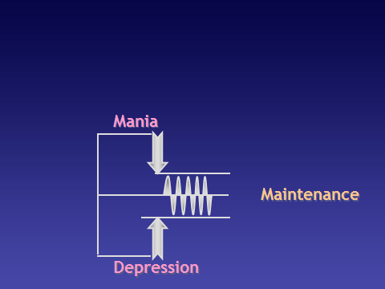
An Ideal Primary Mood Stabilizer
Any drug that stabilizes acute manic symptoms, does not induce depression, and prevents against future relapses into mania or depression

Slide 29
CANMAT Guidelines
 | Acute Mania | Acute Depression | Maintenance
First Line Monotherapy | lithium, divalproex, divalproex ER, olanzapine, risperidone, quetiapine, quetiapine XR, aripiprazole, ziprasidone, asenapine, paliperidone ER | lithium, lamotrigine, quetiapine, quetiapine XR | lithium, lamotrigine (limited efﬁcacy in preventing mania), divalproex, olanzapine, quetiapine, risperidone LAI, aripiprazole
First Line Adjunctive/Combination therapy | with lithium or divalproex: risperidone, quetiapine, olanzapine, aripiprazole, asenapine | lithium or divalproex + SSRI, olanzapine + SSRI, lithium + divalproex, lithium or divalproex + bupropion | with lithium or divalproex: quetiapine, risperidone LAI, aripiprazole, ziprasidone
Bipolar Disorders 2013; 15: 1-44.

Slide 30
Lithium
Gold Standard
MOA
Neuroprotective effect (Increases BDNF)
Reduces glucocorticoid receptor expression
Enhances glutamate signaling
Onset of Action
Requires 10-14 days before complete effect is observed.
Dosing
Guided by plasma levels
Acute treatment: 900-2400 mg od (0.8-1.2 mmol/l)
Maintenance: 400-1200 mg od (0.6-1.0 mmol/l)
Dose adjustments required in renal impairment
Once daily dosing is preferred if patient can tolerate
Courtesy of Beth Sproule, Pharm.D. CAMH; 2009

Slide 31
Lithium Adverse Effects
Early onset, transient, adverse effects (dose related) | Potential long-term effects (idiosyncratic) | Toxic Effects (occur with high serum concentrations)
Nausea Vomiting Diarrhea Muscle weakness and lethargy Polydipsia, polyuria Tremor | Morphological renal changes Hypothyroidism Cardiac effects Leukocytosis Dermatological effects (acne, psoriasis, pruritic dermatitis) Weight gain | Occurs with concentrations ≥ 2.0 mEq/L Presents as worsening in several key symptoms such as: GI – N, V and diarrhea Coordination – coarse hand tremor, unstable gait, slurred speech Cognition – poor concentration, drowsiness, disorientation, coma) Other: seizures, cardiad dysrhythmia, permanent neurological impairments with ataxia
Notes:
Initial or early side effects are often dose related and worse at peak serum concentrations (i.e. 1-2 hours post dose)

Slide 32
Valproate Pharmacology
Mechanism of action not completely known
Indirectly blunts excitatory activity of glutaminergic system
Blocks calcium and sodium channels
Increases serotinergic function
Dosing
Start with 250-500 mg od-bid and increase gradually
Once daily dosing can be used
Dose range 750-3000 mg

Slide 33
Valproate Adverse Effects
Dose Related Adverse Effects
Sedation
Nausea
Tremor
Thrombocytopenia
Idiosyncratic Adverse Effects
Alopecia/Changes in texture or colour of hair
Hepatitis (rare in adults; transient increase in liver enzymes)
Pancreatitis
Chronic Side Effects
Polycystic ovary disease
Weight gain

Slide 34
Lamotrigine Pharmacology
Mechanism of action not completely known
Blocks voltage sensitive sodium channels
Modulates or decreases glutamate release
Dosing
Generally 50-300 mg/day
Usual target dose is 200 mg/day
lower doses combined with valproate (target = 100 mg/day)
higher doses combined with carbamazepine (target = 400 mg/day)
Slow titration recommended
25 mg/day x 2 weeks, titrated slowly increasing 25 mg q 2weeks to approximately 200mg/day

Slide 35
Lamotrigine and Rash
Rash = 10%
high doses, fast titrations, use with valproate, children
within 6 –8 weeks
incidence for serious rash < 1% (toxic epidermal necrolysis or Stevens-Johnson syndrome) – early symptoms include systemic symptoms (e.g. fever, malaise), blisters, lesions on soles, palms and mucous membranes
Courtesy of Beth Sproule, Pharm.D. CAMH; 2009

Slide 36
Atypical Antipsychotics
Mania | First Line (Olanzapine, Risperidone, Quetiapine (XR), Aripiprazole, Ziprasidone, Asenapine, paliperidone)
Depression | First Line: Quetiapine and Quetiapine XR Monotherapy First Line in combination: Olanzapine + SSRI
Maintenance | First Line: Olanzapine, Quetiapine, Risperidone LA inj, Aripiprazole
Bipolar Disorders 2013; 15: 1-44.
Notes:
There is a role across all 3 phases of the illness
Used in acute manic episodes as monotherapy (and combination)
Used to treat concomitant psychotic symptoms (intermittently)
Quetiapine (XR) indicated as monotherapy for depressive episodes
Used as monotherapy and in combination for maintenance treatment

Slide 37
Antidepressants in Bipolar Disorder
Controversial in bipolar disorder
frequently used in practice
Risk: switching into mania
Minimized by ensuring therapeutic dosage of mood stabilizer before adding antidepressant
Increased risk in those who have a history of mania after depression, or those with rapid cycling
Courtesy of Beth Sproule, Pharm.D. CAMH; 2009

Slide 38
Challenges with Current Pharmacological Treatment Strategies
Don’t take into account chronic aspects of bipolar disorder
Treatment is based on active symptom management
Etiology of disorder still not well understood
Not individualized, based on aggregate data
Problems with pharmacotherapy targeting particular neurotransmitters

Slide 39
Therapeutic Drug Monitoring (TDM)
“Measurement of plasma/blood concentrations of a drug to individualize and optimize a patient’s dosage regimen by achieving and maintaining drug concentrations within a target therapeutic window.”
Goal: Rational vs. Routine TDM

Slide 40
TDM Requirements
Only useful if drug concentrations significantly contribute to clinical decision making
Features contributing to usefulness:
Drug response is not readily assessable
Drug concentration is related to pharmacological response
Drug has narrow therapeutic index
Drug has high pharmacokinetic variability

Slide 41
Therapeutic Range in Bipolar Disorder
Evidence for therapeutic range in bipolar disorder
Lithium ✓
Valproate ✗ (✓)
Carbamazepine ✗
Notes:
Establishing therapeutic range
Best evidence
Prospective RCT – patients randomized to different concentrations
Usual evidence
Retrospective – relate concentrations achieved to outcome (correlations or comparing responders and non-responders)

Slide 42
Lithium Therapeutic Range
Both prospective and retrospective study designs
Primarily in treatment of acute mania and in maintenance therapy
Number of patients responding increases as concentration increases
Some patients may respond at levels below 0.8 mmol/L
Unable to identify a priori
Established using 12-hour post dose concentrations with divided dose regimen

Slide 43
12h-Serum Lithium Concentrations
2.0
↑ Risk of Intoxication
1.2
[Li+]
mmol/L
Range with most
evidence of efficacy
0.8
Considered if do not tolerate
higher concentrations
0.6
0.4
0
Courtesy of Beth Sproule, Pharm.D. CAMH; 2009

Slide 44
Factors Affecting Lithium Concentrations
Changes in renal function
Salt intake
Hydration status
Pharmacokinetic drug interactions
Thiazide and K-sparing diuretics
NSAIDs
ACE inhibitors, ARBs

Slide 45
Valproate Therapeutic Range
Not well established for bipolar disorder
No prospective therapeutic range finding studies
Range currently used clinically (300–700 μmol/L, trough) is based on use in the treatment of seizure disorders
Some support for use from retrospective analysis of RCTs

Slide 46
Interpreting TDM Drug Concentrations
Time of blood collection
Time of last dose
Dosage regimen
Duration of therapy (at steady-state?)
Patient characteristics influencing PK/PD (eg. age, gender, concomitant disease)
Concomitant medications
Therapeutic range
or concentration this patient has responded to previously

Slide 47
Indications for Using TDM in Bipolar Disorder
After initiating treatment
After adjusting dose
If treatment is failing
If non-compliance is suspected
When starting or stopping a potentially interacting drug
If there is a change in a patient’s physiology (eg. pregnancy, renal or hepatic impairment)
To assess for drug toxicity or suspected overdose

Slide 48
Non-Pharmacologic Interventions
Predictors of remission/ recovery in bipolar disorder: Caucasian ethnicity Previous manic episode Good social function Out-patient treatment Moderate life satisfaction
In those on Lithium long-term, relapse related to: Atypical features (such as psychosis) Inter-episode symptoms Rapid-cycling
CANMAT Guidelines Bipolar Disorders 2013; 15: 1-44.
Notes:
In patients with rapid cycling treated with lithium
or divalproex, increased risk for non-stabilization
was associated with a history of recent substance use
disorder (SUD), early-life verbal abuse, female
gender, and late onset of first depressive episode

Slide 49
Psychosocial Interventions in Primary Care
Chronic disease management
Collaborative care
Symptom checklists to detect relapse
Internet-based self-management: https://www.moodswings.net.au
CANMAT Guidelines Bipolar Disorders 2013; 15: 1-44.
Notes:
The availability of internet-based strategies has
grown substantially, with demonstrated efficacy in
reducing depressive symptoms and improving psychological
quality of life (24–27).

Slide 50
Adjunct Psychosocial Interventions
Psychoeducation (group)
Cognitive behavioural therapy
Family therapy – Family focused treatment No change in time to depressive or manic episode but shortened course of depressive episode
Interpersonal and social rhythm therapy (IPSRT)
Internet-based self-management
CANMAT Guidelines Bipolar Disorders 2013; 15: 1-44.
Notes:
group psychoeducation, cognitive behavior therapy (CBT), and interpersonal and social rhythm therapy (IPSRT)
have demonstrated significant benefits, both in the treatment of acute depressive episodes and also
as long-term maintenance treatment, including decreased relapse rates, mood fluctuations, need for medications, and hospitalizations, as well as
increased functioning and medication adherence (1–3). Therefore, providing psychological treatments –and, in particular, brief psychoeducation,
which has been demonstrated to be as effective as CBT at much lower cost (22) – is an essential aspect of managing patients with BD.

