Slide 1
Choosing the Best Statistical Test
Quick Decisions

Slide 2
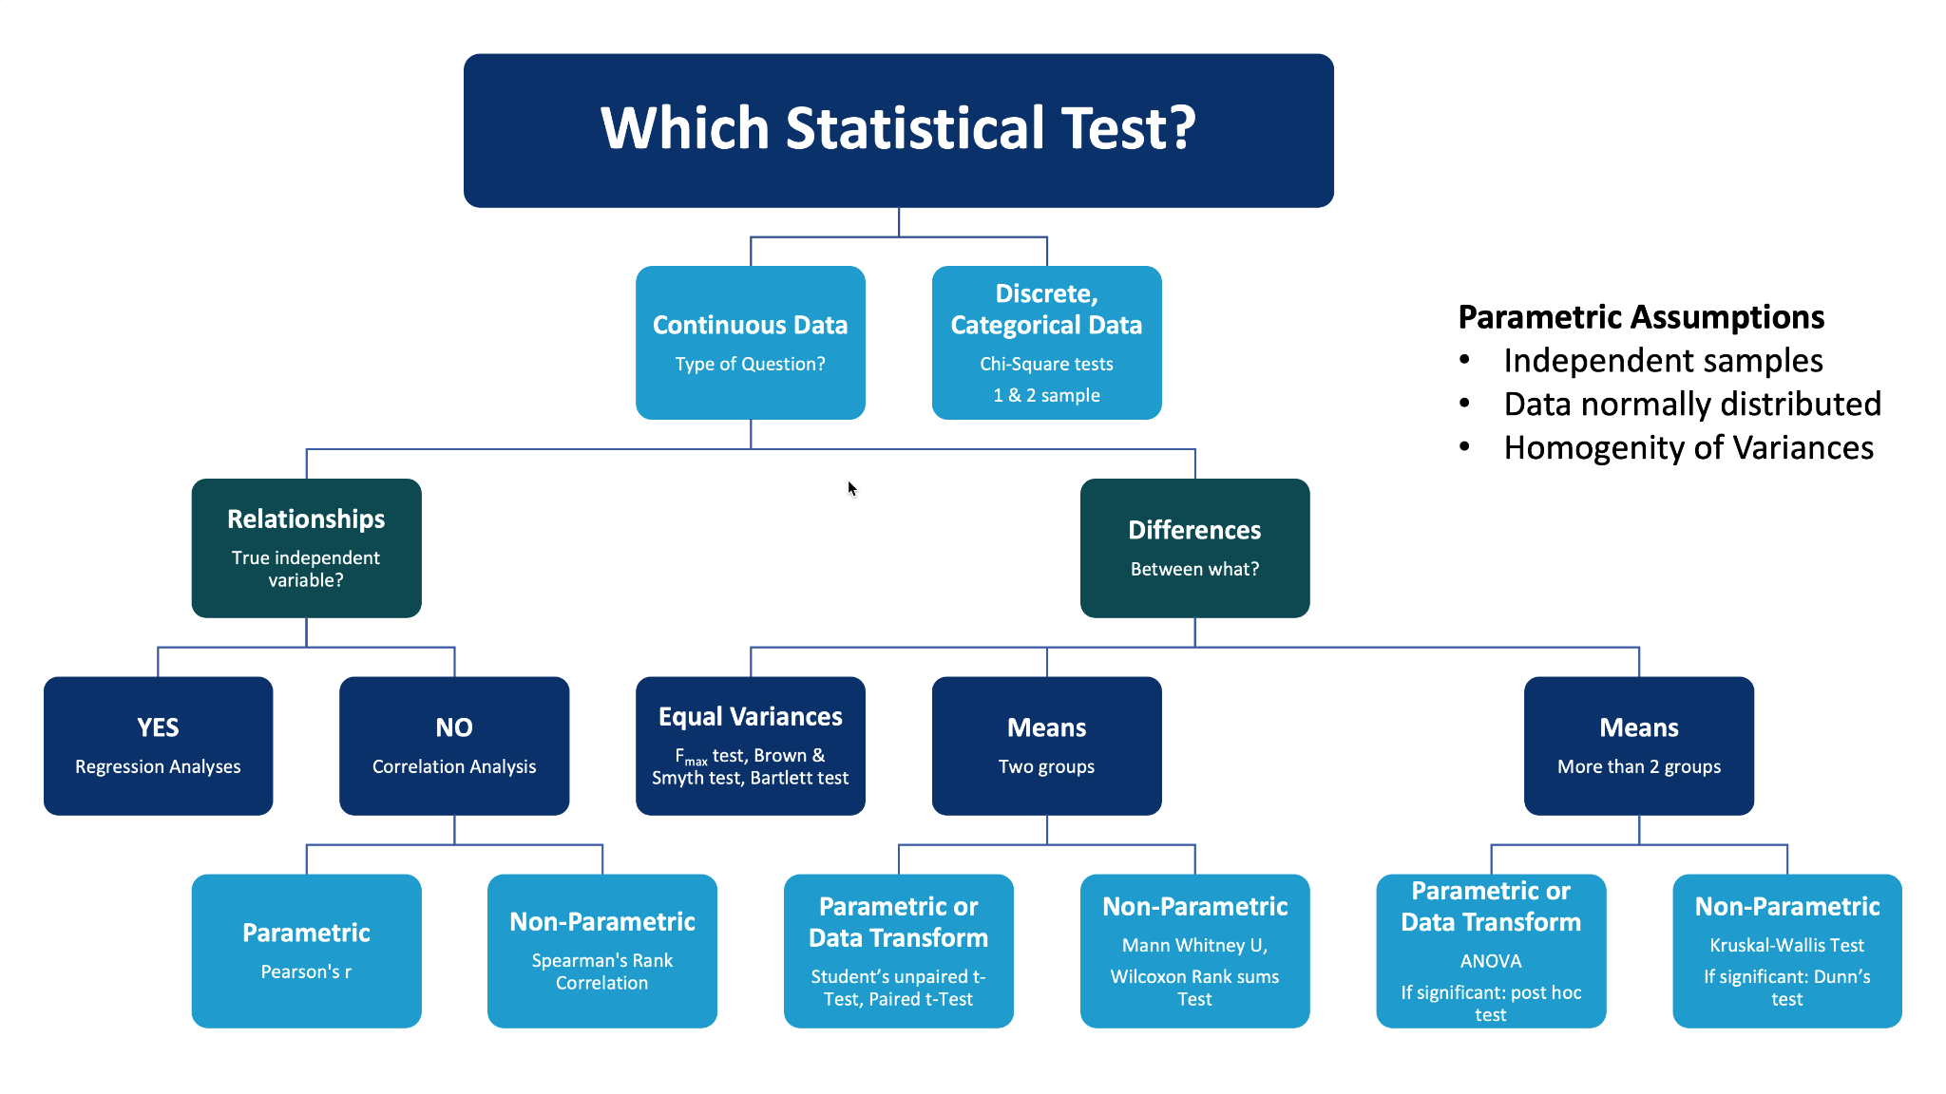

Slide 3
Key Questions Before You Test
What is your outcome variable? Continuous or Categorical
What is your research question? Mean/Median, Proportion, or Association
How many groups / time‑points? (1, 2, >2)
Paired (repeated) or independent samples?
Does the data meet parametric assumptions?

Slide 4
Continuous Outcomes (Means / Medians)
1 group → One‑sample t | Sign test
2 independent groups → Student’s t | Mann‑Whitney U
Paired groups → Paired t | Wilcoxon signed‑rank
>2 groups → ANOVA | Kruskal‑Wallis
Assumptions violated? Transform data or choose non‑parametric

Slide 5
Categorical Outcomes (Proportions)
2×2 or larger tables → Chi‑square test
Small expected counts → Fisher’s exact
Paired proportions → McNemar test
Complex predictors / adjustment → Logistic regression

Slide 6
Correlation & Regression (Relationships)
Correlation: Pearson (parametric) | Spearman/Kendall (non‑parametric)
Continuous outcome → Linear regression (simple / multiple)
Binary outcome → Logistic regression
Time‑to‑event outcome → Cox proportional hazards model

Slide 7
Parametric Assumptions & Quick Tips
Independent observations
Normal distribution (check histograms, Shapiro‑Wilk)
Homogeneity of variances (Levene’s test)
Report effect sizes & 95% CIs, not only p‑values
When in doubt, plot your data first!

