Slide 1
Depressive disorders and Suicidality
Robert Lundin

Slide 2
Unipolar depression
Annual prevalence: between 3% and 10% in Western countries.
Lifetime risk: 10-20%.
Women: 2 times higher rate than men.
Course of illness: Recovery is the rule. However, a relapsing course is common: 80% will have at least one more episode in their lifetime.
The mean duration of an episode is 20 weeks.
Suicide in 10-15% of ever-hospitalised patients.

Slide 3
Where to start looking for symptoms?
Biological
Psychological
Social/functional

Slide 4
Psychological symptoms
Guilt
Poor self confidence
Poor concentration and inattention
Pessimistic outlook
Thoughts of self harm
Poor motivation

Slide 5

Somatic symptoms
Mood worse in mornings
Sleep disturbance
Typically early morning wakening
Appetite and weight changes
Typically weight loss
Loss of libido
Psychomotor agitation/retardation

Slide 6
Psychotic symptoms (severe depression)
Delusions
Hallucinations

Slide 7
Aetiology
Genetic predisposition
Early adversity and stressful life events
Physical illness
Cognitive theories:
‘negative cognitive distortions’
‘depressogenic cognitive style’
Biochemical abnormalities
Reduced serotonergic and noradrenergic neurotransmission
Endocrine abnormalities
Hypercortisolaemia (HPA axis overdrive)

Slide 8
‘Medical’ causes of depression
Neurological
Stroke, Alzheimer’s, Parkinson’s, Epilepsy
Endocrine
Hypothyroidism, Cushing’s, diabetes
Metabolic
Anaemia, Vitamin B12 and folate deficiency, hypercalcaemia
Infective
Influenza, hepatitis, HIV, glandular fever
Neoplastic
Multiple non-metastatic effects of cancer
Drug use
Alcohol, cannabis, cocaine, amphetamine
Medications
Steroids, Beta-blockers, L-dopa

Slide 9
The Stress-Vulnerability Model: Gene x Environment interactions
Environmental Srtess
Full blown disorder
Spectrum conditions
‘Normal’
Genetic predisposition

Slide 10
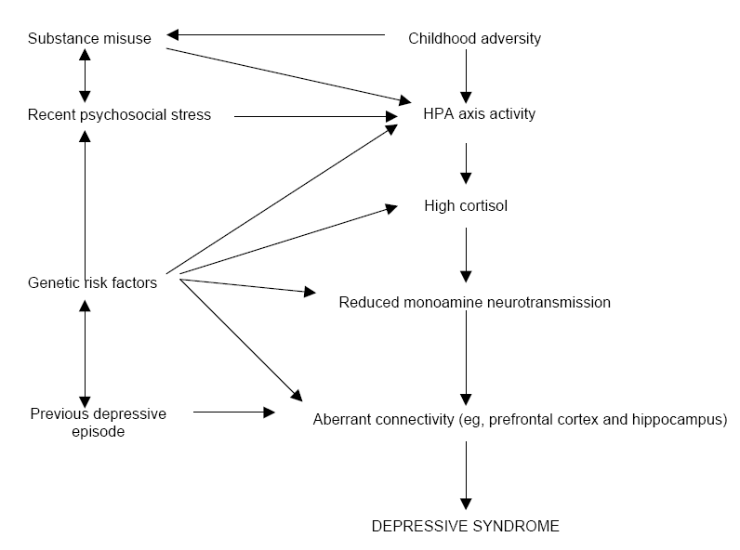
Neurobiological Model of Depression

Slide 11
Depression is a ‘whole body’ disorder:
Depressed patients:
Have an increased risk of obesity and diabetes
Are four times more likely than the general population to have a heart attack
Are more susceptible to infections because of compromised immune systems
Depressed women have decreased bone mineral density and are at greater risk of hip fractures
Often have additional risk factors for ill-health, eg, they smoke more and use more alcohol

Slide 12
DSM-5-TR diagnostic criteria for a major depressive episode
A. Five (or more) of the following symptoms have been present during the same two-week period and represent a change from previous functioning; at least one of the symptoms is either (1) depressed mood or (2) loss of interest or pleasure.
NOTE: Do not include symptoms that are clearly attributable to another medical condition.
1) Depressed mood most of the day, nearly every day, as indicated by either subjective report (eg, feels sad, empty, hopeless) or observations made by others (eg, appears tearful). (NOTE: In children and adolescents, can be irritable mood.)
2) Markedly diminished interest or pleasure in all, or almost all, activities most of the day, nearly every day (as indicated by either subjective account or observation).
3) Significant weight loss when not dieting or weight gain (eg, a change of more than 5% of body weight in a month), or decrease or increase in appetite nearly every day. (NOTE: In children, consider failure to make expected weight gain.)
4) Insomnia or hypersomnia nearly every day.
5) Psychomotor agitation or retardation nearly every day (observable by others, not merely subjective feelings of restlessness or being slowed down).
6) Fatigue or loss of energy nearly every day.
7) Feelings of worthlessness or excessive or inappropriate guilt (which may be delusional) nearly every day (not merely self-reproach or guilt about being sick).
8) Diminished ability to think or concentrate, or indecisiveness, nearly every day (either by their subjective account or as observed by others).
9) Recurrent thoughts of death (not just fear of dying), recurrent suicidal ideation without a specific plan, or a suicide attempt or a specific plan for committing suicide.
B. The symptoms cause clinically significant distress or impairment in social, occupational, or other important areas of functioning.
C. The episode is not attributable to the direct physiological effects of a substance or to another medical condition.
D. The occurrence of the major depressive episode is not better explained by schizoaffective disorder, schizophrenia, schizophreniform disorder, delusional disorder, or other specified and unspecified schizophrenia spectrum and other psychotic disorders.
E. There has never been a manic or hypomanic episode.
Specify:
With anxious distress
With mixed features
With melancholic features
With atypical features
With psychotic features
With catatonia
With peripartum onset
With seasonal pattern

Slide 13
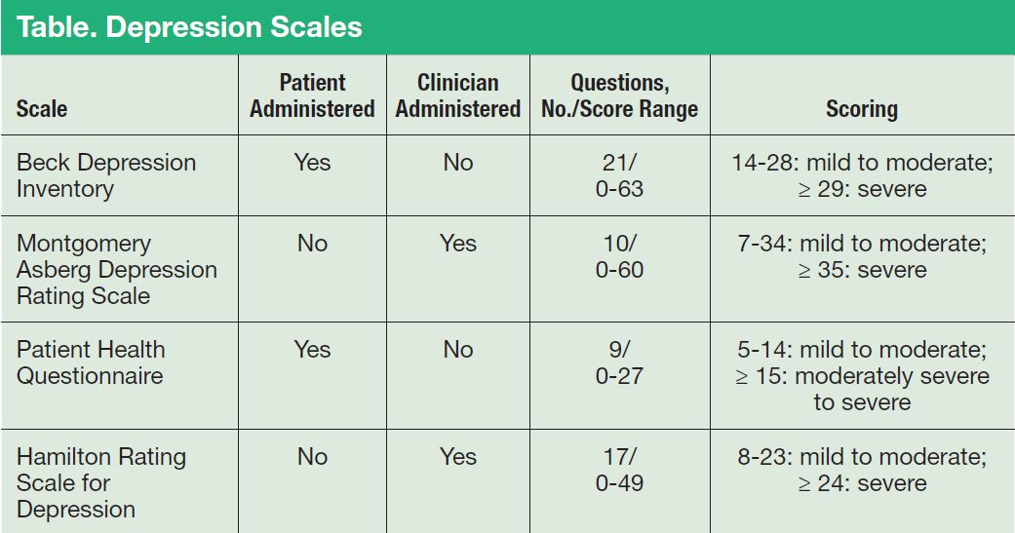
Scales

Slide 14
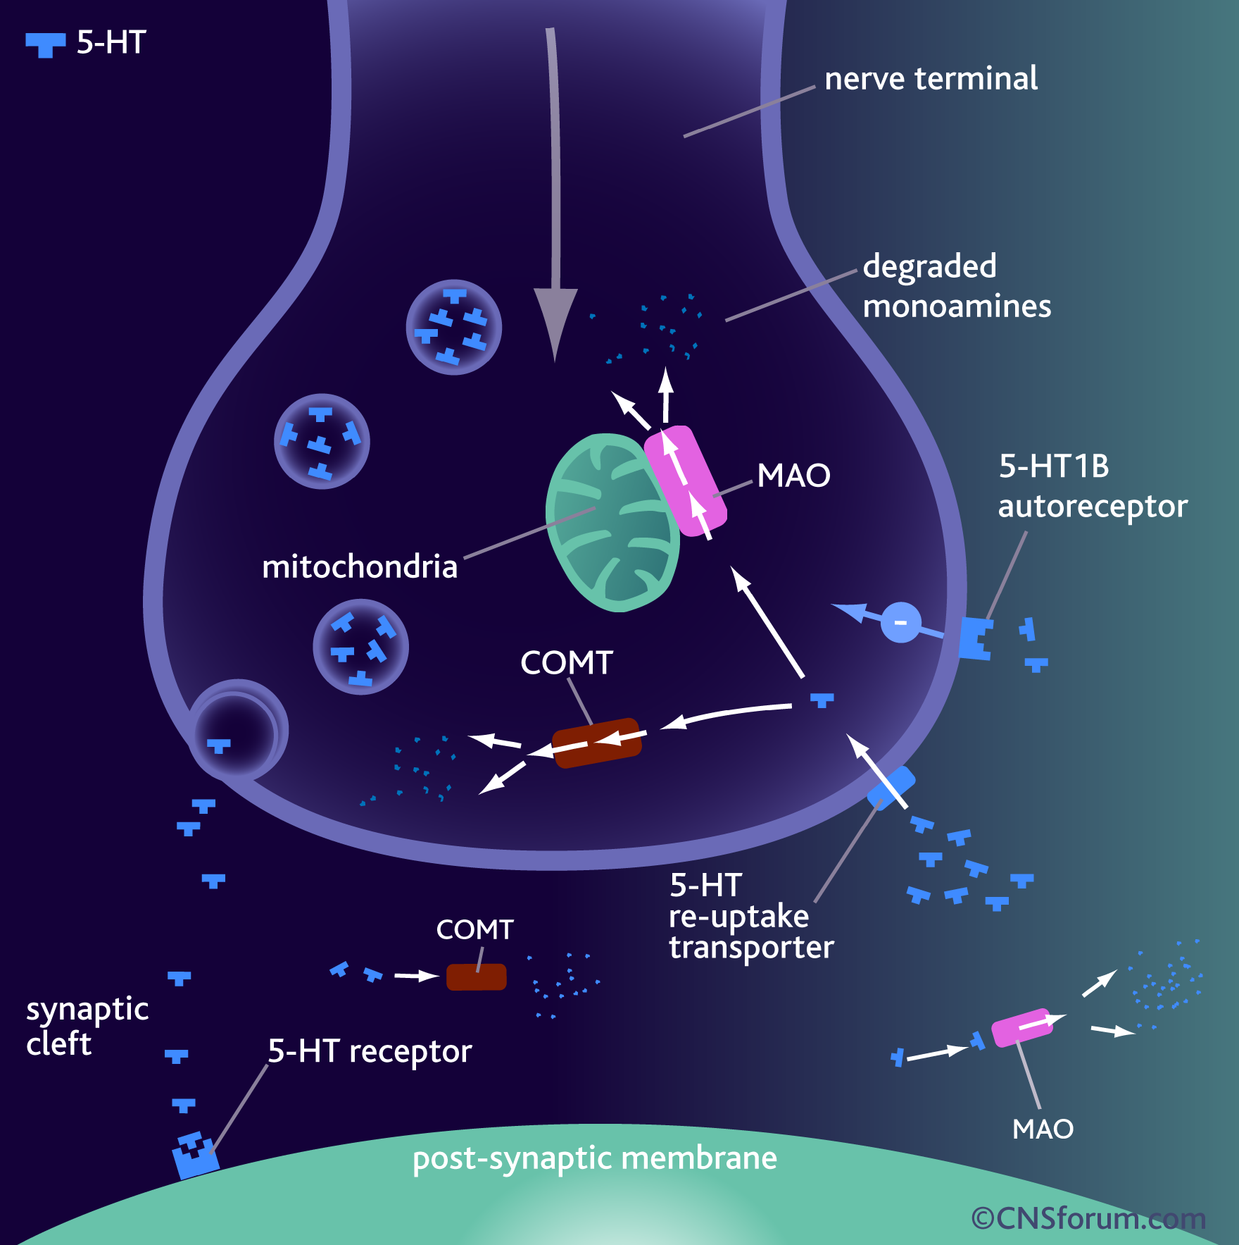
Monoamine hypothesis of depression
Depression is associated with a functional deficiency of monoamine neurotransmission
Serotonin (5-HT) and Noradrenaline (NA) Pathways in the Human Brain

Slide 15
Treatment of depression
BIOLOGICAL – PSYCHOLOGICAL – SOCIAL
Antidepressants:
Treat for 4-6 weeks with one antidepressant at full dose
Continue for at least 6 months after improvement of symptoms
Prophylactic therapy: > 50% of people will suffer another episode within the next 2-3 years if untreated.

Slide 16
Drugs available for use in depression
SSRI Selective serotonin reuptake inhibitors
TCA Tricyclic antidepressants
MAOI Monoamine oxidase inhibitors
RIMA Reversible inhibitors of monoamine oxidase
SNRI Serotonin and noradrenaline reuptake inhibitors

Slide 17
Drugs available for use in depression
SSRI fluoxetine, sertraline, paroxetine, citalporam
TCA amitriptyline, imipramine, clomipramine, etc
MAOI phenelzine, tranylcypromine
RIMA moclobemide
SNRI venlafaxine, duloxetine

Slide 18
Results from STAR*D Level 1 – Citalopram Monotherapy
Most patients remained symptomatic
30% of patients responded to the first antidepressant treatment in this study
Trivedi et al Am J Psychiatry 2006; 163:28–40

Slide 19
First Line Antidepressants: Ranking of Side Effects
Class | Drug | Insomnia | Sedation | Headache | Tremor | Dry Mouth | Sweating | Nausea | Diarrhea | Constipation | Fatigue | Anxiety | Sexual Dysfuntion
SSRI | Citalopram
 | Escitalopram
 | Fluoxetine
 | Fluvoxamine
 | Paroxetine
 | Sertraline
SNRI | Duloxetine
 | Venlafaxine
 | Desvenlafaxine
Others | Bupropion
 | Mirtazapine
0-9%
10-29%
≥30%
*Based on unadjusted rates from Product Monographs

Slide 20
Efficacy + Acceptability = Effectiveness
1.25
Escitalopram
1.20
1.15
Sertraline
Bupropion
1.10
Citalopram
1.05
Acceptability (OR)
FLUOXETINE
1.00
Mirtazapine
0.95
Venlafaxine
Paroxetine
0.90
0.85
Duloxetine
Fluvoxamine
0.80
0.8
0.9
1.0
1.1
1.2
1.3
1.4
Efficacy (OR)
Cipriani et al. The Lancet 2009.

Slide 21
Serotonin Syndrome: Differential Diagnosis
 | Serotonin Syndrome | NMS | Anticholinergic Syndrome
Core features
Laboratory Findings
Examples | SSRI + SSRI St. John’s Wort + SSRI | Anitpsychotic + antipsychotic (e.g. haloperidol + risperidone) | High use of diphenhydramine + TCA (amitriptyline)
Hyperthermia
Mental status changes
Restlessness
Myoclonus
Diaphoresis
Diarrhea
“Hypomania”
Hyperthermia
Mental status changes
Muteness
Autonomic instability
Severe EPS
Hyperthermia
Mental status changes
⬇ sweating
Tachycardia
Dilated pupils
Constipation
No EPS
Antidepressant effects, GI side-effects, sexual dysfunction
Antidepressant effects, sympathetic nervous system effects
Antidepressant effects, psychomotor activation, activation of reward pathways
Antidepressant effects, antipsychotic effects, anxiety, insomnia
No specific findings
Elevated CK, WBC, LFTs
Myoglobinuria
No specific findings
CNS depression, sedation, weight gain
Anticholinergic syndrome
Postural hypotension, dizziness

Slide 22
Psychological therapies
Supportive
Problem-solving
Cognitive and behavioural therapy (CBT)
Interpersonal psychotherapy
Psychodynamic psychotherapy

Slide 23
How Long Should Index Treatment be Continued Before Determined to be Resistant?
Patients who went on to have a stable response at follow-up based on improvement at week 2 (meta-analysis of 41 trials, n=6562)
Early improvement at week 2 (n=4284)
No improvement at week 2 (n=2263)
went on to have a stable response
did NOT go on to have a stable response
Stable response
No stable response
Lack of improvement in first 2 weeks of treatment may indicate a change in therapy should be considered
*20% reduction in depression symptom severity at 2 weeks. Follow-up response determined at week 4-8.
Szegedi J Clin Psych. 2009;70:344.

Slide 24
Treatment resistant depression:
Lithium augmentation
Thyroid hormones
Combinations of antidepressants
Monoamine Oxidase Inhibitors (MAOI)
ECT

Slide 25
Electroconvulsive therapy (ECT)
Is the treatment of choice for severe depression (often with psychotic features)
Anaesthetist present; short-acting anaesthetic plus muscle relaxant; oxygenation before and after the seizure

Slide 26

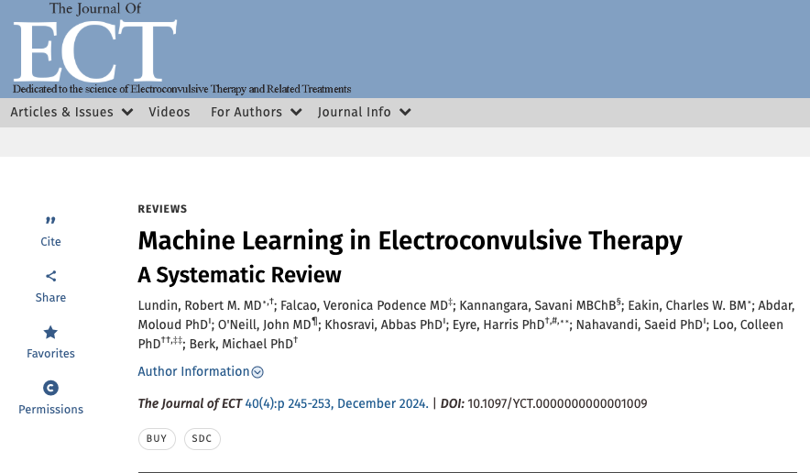

Slide 27
Suicidality
Men are three times more likely to die by suicide than women (although women make more suicide attempts).
There are some groups of people that experience higher rates of suicide due to sustained trauma, racism or discrimination, such as Aboriginal and Torres Strait Islander people and gay, lesbian, bisexual, transgender and intersex people, in particular, trans and gender diverse people.
People recently discharged from acute psychiatric services are particularly vulnerable, exhibiting a suicide risk 100 to 200 times greater than normal in the month after discharge.
Adolescents and young people can also face risk factors that may elevate their suicide risk, from mood and anxiety disorders to substance use, bullying, feelings of isolation, or the influence of close friends who have taken their own lives.
The elderly face unique risks stemming from their declining health, social isolation, recent bereavements and concerns about being a burden to others

Slide 28
Guiding principles
Positive engagement
Gather information directly from the person
Gather collateral information
Complete a thorough assessment
Ensure there is a follow-up assessment
Local guidelines for local settings
https://www.safercare.vic.gov.au/best-practice-improvement/clinical-guidance/mental-health/suicide-prevention-in-mental-health-services-guidelines

