Slide 1
Introduction to psychiatry teaching programme
Dr Robert Michael Lundin
rlundin@mbph.org.au

Slide 2
Session overview
About the programme
History taking in psychiatry
Mental State Examination
Writing notes
Feedback

Slide 3
Absence
Always happy to share slides

Slide 4
History taking in psychiatry
Dr Robert Michael Lundin
rlundin@mbph.org.au

Slide 5
Talking to psychiatric patients
First some generic advice
Bring someone along
Remember duress alarms
NEVER lie
Establish rapport
Free flow vs structured
Think about positioning

Slide 6
Talking about: Psychosis
Sometimes when people are stressed they can have strange experiences. Have you ever experienced this?
Have you ever heard voices, or people talking about you when no-one else is around?
Have you ever felt like your thoughts are being interfered with in some way? E.g. thoughts being put into your head, or taken out or even broadcasted to other people so that other people know what you are thinking?
Do you ever receive messages from the TV or radio?
Is anyone trying to hurt you?

Slide 7
Talking about: Hallucinations
Auditory hallucinations
  Onset and duration
  Internal / external space
  Real / solid / vivid / clear
  Gender and number of voices
  Do they recognise the voices
  Running commentary
  Content (good or bad)
  Command hallucinations
Olfactory and visual hallucinations (indicate organic possibility)
Tactile and gustatory

Slide 8
Talking about: Depression
On a scale of 1-10, if 10 was really down, where would you put yourself?
What are the kinds of things you normally enjoy doing and do you still enjoy doing them?
What have your energy levels been like?
How is your concentration? Do you find it difficult taking things in when watching TV or reading a book?
What are your plans for the future?
Do you think other people would be better off without you?

Slide 9
Talking about: Suicide
Sometimes when people get depressed they may find life not worth living - have you felt like this?
What thoughts have crossed your mind?
What have you planned?
Have you made any arrangements for after your death?
What stops you from going through with it?

Slide 10
Talking about: Mania
Have you ever had the opposite of depression when you have been extremely happy, over the top, doing things out of character? (for 2 weeks or more)
What has your sleep been like?
Do you have any special powers that others don’t?
Do you ever find your thoughts racing?
Have you spent more money than usual recently?

Slide 11
The psychiatric history
Introductory information
Presenting complaint (history of)
Past psychiatric history
Past medical history
Medication history
Substance use
Family history
Social history
Personal history

Slide 12
Mental State Examination
Dr Robert Michael Lundin
rlundin@mbph.org.au

Slide 13
Mental state examination
✓ Appearance and behaviour
✓ Speech
✓ Mood
✓ Thought
✓ Perception
✓ Cognition
✓ Insight and judgement
✓ Risk

Slide 14
Appearance and behaviour
✓ Appearance and behaviour
✓ Speech
✓ Mood
✓ Thought
✓ Perception
✓ Cognition
✓ Insight and judgement
✓ Risk
Level of consciousness
  Hyperalert, vigilant, alert, somnolent
Appearance
  Body build, posture, general physical condition, grooming and hygiene, dress, physical stigmata
Behaviour and attitudes towards examiner
  Facial expressions, degree of eye contact, quality of rapport
Motor activity (abnormalities of movement)
  Agitation, retardation, tremor, dystonia, akathisia, chorea, catalepsy

Slide 15
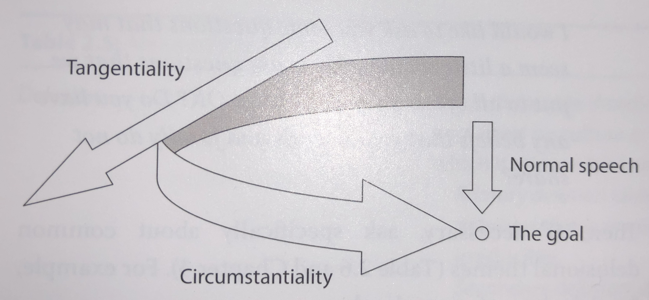
Speech
✓ Appearance and behaviour
✓ Speech
✓ Mood
✓ Thought
✓ Perception
✓ Cognition
✓ Insight and judgement
✓ Risk
Amount
  Poverty vs logorrhoea
Rate
  Pressured, mutism, retardation
Volume and tone
  Decreased, increased
Speech form
  Clang association, word salad, echolalia, paraphrasia and many more

Slide 16
Mood
✓ Appearance and behaviour
✓ Speech
✓ Mood
✓ Thought
✓ Perception
✓ Cognition
✓ Insight and judgement
✓ Risk
Mood
  Euthymic, dysthymic, hyperthymic, cyclothymic
  Anxiety, irritability, depression, anhedonia, euphoria, ecstasy, apathy
Affect
  Blunted, labile, flat, congruent vs incongruent, perplexed
Suicidal ideations
  Any?

Slide 17
Thought
✓ Appearance and behaviour
✓ Speech
✓ Mood
✓ Thought
✓ Perception
✓ Cognition
✓ Insight and judgement
✓ Risk
Stream of thought
  Pressured, poverty, blocking
Form of thought
  Flight of ideas, loosening of associations, over-inclusive, concrete
Content
  Phobias, rumination, obsessions, delusions, overvalued ideas, ideas of reference
  Delusional themes
    Persecution, control, reference, misidentification, grandeur, religious, guilt, somatic, nihilistic, love and jealousy

Slide 18
Perception
✓ Appearance and behaviour
✓ Speech
✓ Mood
✓ Thought
✓ Perception
✓ Cognition
✓ Insight and judgement
✓ Risk
Auditory hallucinations
Visual hallucinations
Pseudo-hallucinations
Illusions
Olfactory and gustatory
Tactile

Slide 19
Cognition
✓ Appearance and behaviour
✓ Speech
✓ Mood
✓ Thought
✓ Perception
✓ Cognition
✓ Insight and judgement
✓ Risk
Orientation
Memory
Attention and concentration

Slide 20
Insight and judgement
✓ Appearance and behaviour
✓ Speech
✓ Mood
✓ Thought
✓ Perception
✓ Cognition
✓ Insight and judgement
✓ Risk
Does the patient believe that something is wrong with them?
Are they willing to accept treatment?

Slide 21
Risk
✓ Appearance and behaviour
✓ Speech
✓ Mood
✓ Thought
✓ Perception
✓ Cognition
✓ Insight and judgement
✓ Risk
A full session on its own, but try to identify specific risks relating to the patient
Relapse, non-compliance, substance abuse, suicidal ideations = usual suspects

Slide 22
Writing notes
Dr Robert Michael Lundin
rlundin@mbph.org.au

Slide 23
Aug 2019 13:00 | Inpatient MH Progress Note - Completed | Dr Robert Lundin Registrar
 | SMO review
 | Patient was seen on the ward following admission by SMO Dr Doctor Background for admission - Suicide attempted last night - tried to hang himself - was drunk at the time - Suicidal thoughts for a week - Was paid last night, then went to buy a rope and bought/drank 3 litres of wine (13%) - Started drinking at 19:00, then fell asleep - woke up in the morning in his car - then drove home - Told his mother and they argued, she believing that he had taken drugs - mother brought him to CADS appointment and was from there sent him on to hospital (ED) MH background - Reports previous suicide attempts - went to buy a gun, bought it and crashed his car but was unable to pull the triggers - this was 6-8 months ago - Multiple overdoses (x10) - had seizures, vomiting, out-of-body experiences - Says Olanzapine was started for drug-induced psychosis – when psychotic is “not himself, violent and breaks things,” does not remember what he has done when he wakes up the next morning - Reports that he used to believe people were talking about him and getting paranoid about other people - This would be at work or in public - makes him worried and anxious when he hears this - E.g. hearing someone talk about “druggies” and Patient believes this is about him Suicidal ideations - None at the moment - Asked to speak to nurses if this returns - If it happens again he will try to distract himself MSE - Young Caucasian male with tattoos on both arms, engages well in interview, smiling and joking about attempts - Speech normal - Mood euthymic, affect reactive - appropriate laughing when discussing falling asleep - Thought form linear, logical - No current perceptual disturbances - No clear delusional content - Focussed on medications, no current thoughts of self-harm - Insight unclear, needs further exploration - Risks – chronic suicidal ideations, no serious attempts in the past
Social
- Lives with his mother
- Works at Business
Impression
- So far no clear signs of depression or psychosis, but will review mane
- Signs of borderline personality traits
Medications
- Takes fluoxetine 40mg and olanzapine 5mg (both nocte)
Physical health
- Takes regular weed and codeine at the moment - smoking every day
- Started taking drugs at 16 after a co-worker
- Has also tried acid, MDHA, speech, magic mushrooms, benzos, painkillers, Ritalin and others
- Used to do drugs more heavily over the past year
Plan
1) Chart regular medications - fluoxetine moved to mane
2) Taken off 10 minute observations
3) Attempt meeting with mother and father mane (11:00)

Slide 24
Aug 2019 13:00 | Inpatient MH Progress Note - Completed | Dr Robert Lundin Registrar
 | Review
 | Patient was seen on the ward by Dr Doctor Progress on the ward - Patient has been doing well on the ward - Eating and sleep well, making friends on the ward - Patient denies any suicidal thoughts Impression from treatment team - Following the family meeting today the impression from treatment team and family is that there are no signs of major depression - It is more likely that the suicidal ideations are related to a personality disorder or past trauma (like parents separating at age 9) - Also related to ongoing drug use - Family meeting earlier today highlighted an appointment next week to transfer services to adult - Psychotherapy in community is being planned and will be required - For leave with family over the weekend (4 hours daily) MSE - Casually dressed in hoodie, engaging well in interview - Speech normal - Mood euthymic, affect reactive - Thought form linear, logical - No current perceptual disturbances - No clear delusional content - Focussed on leave, no current thoughts of self-harm - Insight appears good - Risks – chronic suicidal ideations, ongoing drug use Plan 1) RN to call community team 2) Aim for discharge Monday 3) Has x3 escorted and 4 hours with family 4) Urine toxicology on return from leave

Slide 25
Feedback
Dr Robert Michael Lundin
rlundin@mbph.org.au

