Slide 1
Artificial Intelligence in Psychiatric Education and Training (2016–2024)
Journal Club Presentation
Based on Scoping Review of Trends
Mary Madu

Slide 2
Background
AI has rapidly influenced psychiatry and medical education since ChatGPT’s release (2022).
Limited literature specific to psychiatry training.
Psychiatry uniquely relies on empathy and interpersonal connection — raising questions about AI’s role.

Slide 3
Definition of Key Terms
Scoping review: Explores broader research landscapes, clarifies concepts, and identifies gaps.
Systematic review: is a structured and comprehensive synthesis of research evidence that aims to answer a specific research question by identifying, evaluating, and synthesizing all relevant studies.

Slide 4
Grey literature: Information produced outside of traditional academic publishing channels including policy documents and working papers, often lacking peer review literature.
PAGER (Patterns, Advances, Gaps, Evidence for practice and Research recommendations) framework.

Slide 5
Rationale/Objectives for the study
To map how AI is discussed in psychiatric education globally as of 2024.
Review global literature on AI use in psychiatric education/training.
Identify patterns, advances, gaps, evidence for practice, and research recommendations.
Provide an overview for future curriculum design and training adaptation.

Slide 6
Methods Overview
Scoping review following Arksey & O’Malley framework.
Databases: PubMed, Embase, PsycINFO, Scopus + grey literature.
Inclusion: Learning-based AI applied to psychiatric education.
Excluded: Classical (rule-based) AI, abstracts, non-English records.

Slide 7
Search Strategy
Comprehensive search conducted on 8 May 2024.
Search terms combined ‘AI’, ‘psychiatry’, ‘training’, ‘education’, and large language models.
Nine training organizations contacted for grey literature.

Slide 8
Data Collection and Analysis
26 records (2016–2024) included.
61.5% published in 2023–24.
Majority: North America & Europe.
PAGER framework used for theme synthesis.

Slide 9
Publication Trend (2016–2024)

Slide 10
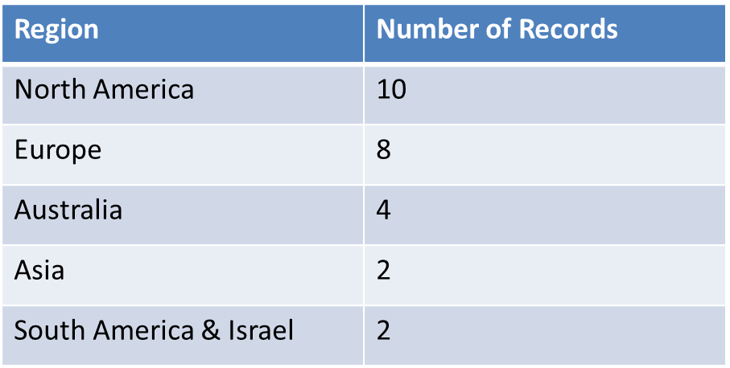
Geographic Distribution of Studies

Slide 11
Key Themes (PAGER Framework)
AI Curriculum imperative
AI for educational resource development
AI for clinical skills
AI for assessment
Academic integrity and ethics
Competing priorities and directions.

Slide 12
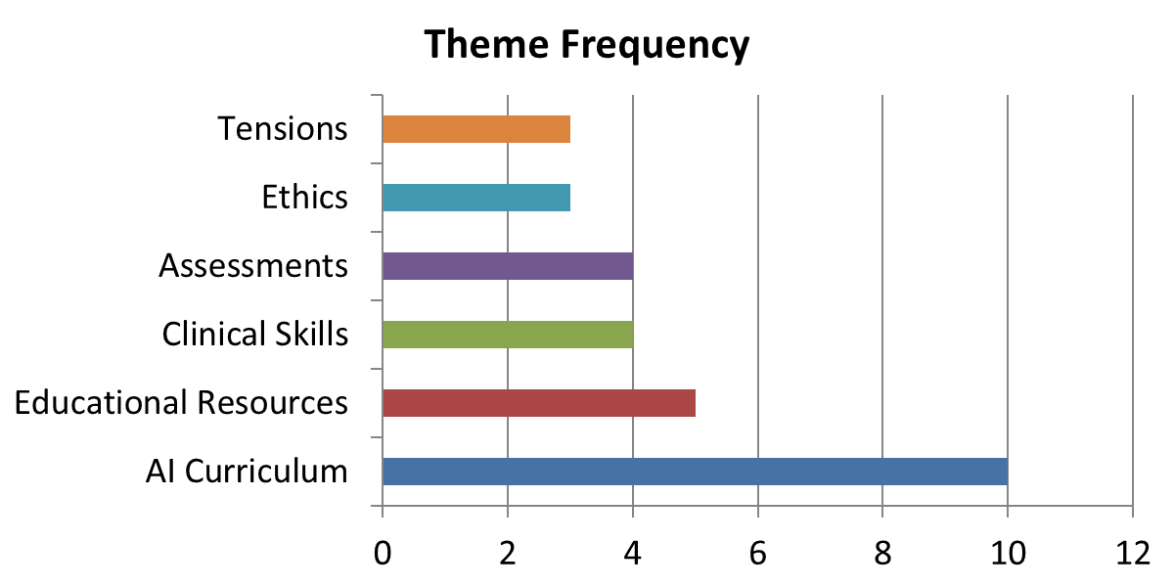
Frequency of Themes Across Records

Slide 13
Theme 1: Imperative for an AI Curriculum
Psychiatry curricula lack AI literacy and informatics training.
Trainees should learn to interpret AI outputs, explain to patients, and apply ethically.
Core competencies adapted from ACGME framework (Torous et al., 2018).

Slide 14
Theme 2: AI for Educational Resources
ChatGPT used to generate case vignettes, tutorials, and curricula.
Benefits: Efficiency, translation, accessibility.
Risks: Bias, hallucinations, reduced critical thinking.
Consensus: AI should complement—not replace—educators.

Slide 15
Theme 3: AI for Clinical Skills Training
NLP-enhanced virtual patients simulate psychiatric interviews with realism.
Potential for empathy and non-verbal feedback.
Benefits: standardization, access to rare/risky cases.
Limitations: cost, realism, and ethical issues.

Slide 16
Theme 4: AI in Assessments
ChatGPT-4 passes medical student-level psychiatry exams (>90%).
Performance declines on specialist exams.
AI can generate test items (e.g., Script Concordance Tests).
Implications for rethinking exam formats and integrity.

Slide 17
Theme 5: Academic Integrity and Ethics
Only Hong Kong Academy of Medicine has AI-use policy.
Requires declaration of AI use, originality assurance, and oral components.
Concerns: privacy, data storage, and ethical oversight.
Benefits: improved access in low-resource settings.

Slide 18
Theme 6: Tensions in Psychiatry
Balance between human empathy and AI augmentation.
Some fear AI reduces therapeutic relationships; others see empowerment.
Challenge: integrate innovation while preserving psychiatry’s interpersonal essence.

Slide 19
Discussion
Emerging Field – Most studies were published from 2023 onward, reflecting that AI in psychiatric education is still in its infancy and rapidly evolving.
Breadth but Limited Depth – The literature spans diverse AI applications but often lacks methodological rigour; many papers are proof-of-concept or opinion-based.
Need for Rigorous Research – Strong demand for well-designed qualitative and quantitative studies exploring psychiatrists’ and trainees’ attitudes, experiences, and outcomes with AI.
Proof-of-Concept Focus – Existing quantitative studies often stop at surface comparisons (e.g., accuracy rates) without exploring deeper qualitative differences in reasoning or learning.

Slide 20
Opportunities for Future Research – Studies could analyse AI responses using frameworks like Bloom’s taxonomy to assess cognitive complexity and improve AI explainability.
Impact on Educators – AI can support educators by generating teaching materials, case vignettes, and assessments, but still requires close human supervision.
Impact on Learners – AI can act as a personalised tutor, offering real-time feedback and supporting self-directed learning, though risks of over-reliance remain.
Changing Educator Roles – AI may shift educators’ focus from content delivery to guiding, curating, and quality-checking AI outputs (reflecting Moravec’s paradox).

Slide 21
Policy and Integrity Gaps – Most psychiatric training bodies lack formal policies for AI use in education or clinical training, raising concerns about integrity and misuse.
AI Literacy as Core Competence – There is a pressing need to embed AI fundamentals into psychiatry curricula so future psychiatrists can engage critically and safely with AI in clinical practice.

Slide 22
Implications for Psychiatric Training
Integrate AI literacy into RANZCP and university curricula.
Prioritize ethics, empathy, and critical thinking.
Train psychiatrists to interpret and supervise AI tools in practice.

Slide 23
Future Research Directions
Delphi studies to define AI competencies.
Qualitative studies on psychiatrist attitudes.
Development of local LLMs ensuring confidentiality.
Validation studies for AI-assisted assessments.

Slide 24
Critique

Slide 25
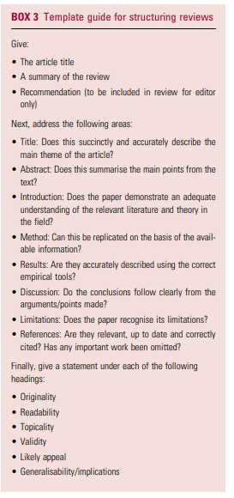
Template guide for structuring reviews Halder et.al. 2021

Slide 26
Addressing
Originality-Run through AI-no plagiarism flagged.
Readability
Topicality
Validity
Likely appeal

Slide 27
The article title succinctly and accurately described the main theme of the article.
Abstract summarised the main points from the text.
The introduction adequately demonstrated adequate understanding of the relevant literature and theory of the field.
Based on the methodology it could be replicated.

Slide 28
The results were adequately described using the correct empirical tools.
The discussion followed clearly from the points made.

Slide 29
Limitations
Limited data as many of the included records were opinion pieces.
This scoping review represented an important snapshot of trends during the early years of scholarly interest in this topic.
This is rapidly evolving field with constant updates of information and swift obsolescence of research findings.

Slide 30
Conclusions
AI’s role in psychiatric education is transformative but emerging.
Requires cautious integration balancing ethics, empathy, and innovation.
Preparing psychiatrists for AI-enhanced practice is an urgent educational priority.

Slide 31
References
Bradbury-Jones, C., Aveyard, H., Herber, O. R., Isham, L., Taylor, J., & O’Malley, L. (2021). Scoping reviews: the PAGER framework for improving the quality of reporting. International Journal of Social Research Methodology, 25(4), 457–470. https://doi.org/10.1080/13645579.2021.1899596
Kolding, S., Lundin, R. M., Hansen, L., & Østergaard, S. D. (2024). Use of generative artificial intelligence (AI) in psychiatry and mental health care: a systematic review. Acta neuropsychiatrica, 37, e37. https://doi.org/10.1017/neu.2024.50

