Slide 1
Evaluating Meta-Analyses and RCTs

Slide 2
Meta-Analysis: Key Advantages
Increased statistical power
Clarifies contradictions in literature
Enables comprehensive evidence synthesis
Notes:
This slide highlights why meta-analysis is valued in evidence-based medicine—particularly for its ability to pool data and increase statistical power.

Slide 3
Critical Issues in Meta-Analysis
Garbage-in garbage-out (GIGO)
Publication bias
Apples vs. oranges: heterogeneity
Missing data and statistical model disagreements
Notes:
These common issues may compromise meta-analysis validity. Emphasize the need for rigorous methods and transparent inclusion criteria.

Slide 4
Forest Plot Interpretation
Point estimate: square size indicates weight
01
Confidence intervals: line length shows precision
02
Diamond: pooled effect size
03
Line of no effect at RR=1 or mean diff=0
04
Notes:
Discuss how to visually interpret forest plots, including confidence intervals and the implications of diamond location relative to the line of no effect.

Slide 5
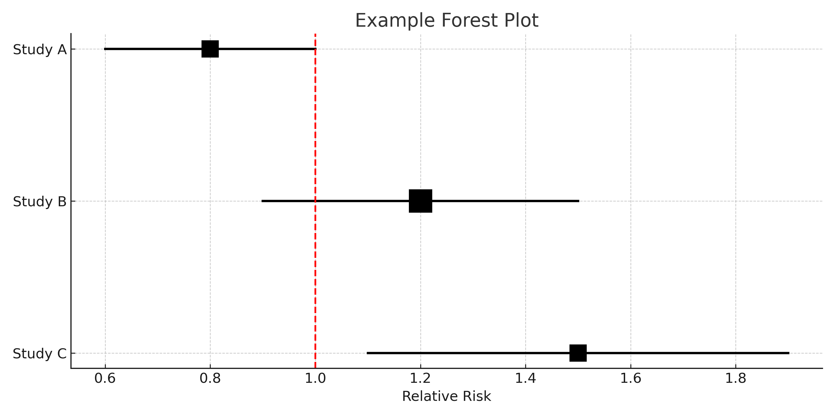
Example Forest Plot

Slide 6
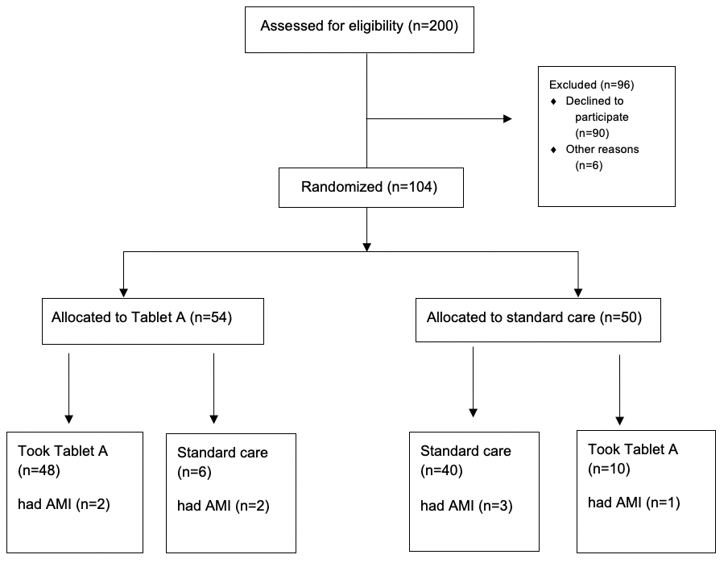
RCTs

Slide 7
Intention-To-Treat (ITT) Principle
Participants analyzed in assigned group, regardless of adherence
Preserves randomization
Provides conservative and pragmatic estimate of effect
Notes:
Reinforce that ITT protects the integrity of randomization and improves generalizability, though it may dilute treatment effects.

Slide 8
Managing Missing Data in ITT
Last Observation Carried Forward (LOCF)
Worst-case scenario analysis
Imputation (mean, hot-deck)
Statistical models (regression, growth curve, random effects)
Notes:
Review methods used to address attrition in ITT analyses. Stress the importance of performing sensitivity analyses to check robustness.

Slide 9
Alternatives to ITT
Per Protocol (PP): Includes only adherent subjects
Treatment Received (TR): Based on actual treatment, not allocation
May introduce bias, compromise randomization
Notes:
Highlight that while these alternatives offer insight into efficacy, they risk losing the unbiased nature of RCT design.

Slide 10
Advantages and Limitations of ITT
Advantages:
Retains randomization balance
Reflects real-world use
Avoids bias
Limitations:
Conservative estimate
Harder to interpret with high cross-over
Notes:
Summarize the trade-offs of ITT vs. other analytic approaches. ITT is often preferred, but not always ideal depending on study context.

