Slide 1
Psychotic disorders
Dr Robert Lundin

Slide 2
Psychosis is:
Delusion
-> fixed false belief not changeable with reason.
-> Bizarre, non-bizarre, referential, paranoid, thought extraction etc.
An abnormal state of ‘mind’, where one’s sense of reality is altered to various degrees.
This alteration is characterized by changes in:
Thought form -> disordered (such as derailment, tangential thoughts, circumstantiality etc.)
Thought content -> illogical thoughts, delusions* (when severe) or overvalued ideas (when mild).
Perceptual abnormality -> illusions (misinterpretation of external environment) or hallucinations (internally created abnormal perceptions)
Insight & Judgement -> diminished.
Additional symptoms called ‘negative symptoms’ -> avolition, anhedonia, affect (reduced to degrees), alogia (speech defect).

Slide 3
Psychosis is:
Delusion
-> fixed false belief not changeable with reason.
-> Bizarre, non-bizarre, referential, paranoid, thought extraction etc.
An abnormal state of ‘mind’, where one’s sense of reality is altered to various degrees.
Can have a secondary or primary cause:
Primary: due to syndromes called mental and behavioural disorders in DSM and ICD:
Schizophrenia and related disorders (including delusional disorder).
Mood disorders (unipolar as well as bipolar)

Slide 4
Secondary causes:
Secondary: due to a definite found ‘external’ cause such as other medical conditions or substances/ medications
Normal states
hypnopompic/hypnogogic hallucinations
sleep deprivation
bereavement
2. Other medical conditions:
Endocrine disorders: hyper-/hypothyroidism, Cushing’s, hypoparathyroidism, post-partum psychosis*
Auto-immune disorders: SLE, anti-NMDA R encephalitis, Hashimoto’s, Sarcoidosis
Neurodegenerative disorders: Lewy-body, Alzheimer’s, Parkinson’s
Other neurological disorders: neoplasms, CVA, EPILEPSY/ seizures, multiple sclerosis
CNS infectious disorders: HIV, viral encephalitis, malaria, syphilis
Genetic disorders of metabolism such as porphyria.
Nutritional abnormalities: B12 deficiency
Poisons: heavy metals, fungal, industrial
Parasite infestations: neurocysticercosis
Para-neoplastic syndromes

Slide 5
Case
Suggestions?

Slide 6

First Episode Psychosis (FEP)
Can have any of the causes discussed above, thus:
Full comprehensive history and examination needed to determine cause for proper management.
Examination must include ALL systems, especially CNS.
Special Investigations: CBC, U&E, LFT, TFT, B12 and if needed HIV, MRI, EEG, aNMDA.
fMRI: significant changes in under- and over-activity in various regions (see schizophrenia)

Slide 7
First Episode Psychosis (FEP)
FEP will in time – with proper investigation – show what underlying disorder is present.
Durations:
Less than a month -> Brief Psychotic Disorder
Up to 6 months -> Schizophreniform Disorder (schizophrenia-like disorder, but less in duration).
More than 6 months, with all inclusion and exclusion criteria for schizophrenia present -> Schizophrenia
If mood component is present, consider Schizoaffective Disorder, BUT, the DSM criteria must be followed
or diagnosis may be incorrect (vs MDD, severe with psychosis, or Bipolar Disorder, I, manic, severe with psychosis).

Slide 8
With mild FEP, aim not to prescribe anti-psychotic for the first 24 – 48 hours if possible. Rather give benzodiazepines and actively search for underlying cause.
If post ictal psychosis, will increase risk if seizure.
Management of FEP
Acute setting
1. With agitation/ aggression:
-> Safety first for personnel & patient(s)
-> De-escalation techniques
-> Skilled restrained by trained personnel only
-> Sedation/ Tranquilization (be mindful of qTc) Combination of APA and NICE guidelines
-> Agitation/ aggression can be due to multiple medical, substance and psychiatric conditions

Slide 9
Management of FEP
REMEMBER: the degree of agitation does NOT equal the dose; titrate according to weight and response.
Lorazepam 2-4mg po/imi stat 8 hourly (keep eye on respiratory effort)
Olanzapine 5 – 10mg oral dispersible or IMI (keep eye on BP): IMI not to be given within 2 hours of Lorazepam IMI if unsuccessful, CAREFULLY consider
Haloperidol 5mg oral/ IMI & Promethazine 25mg oral/ 5 – 10mg IMI (monitor ECG, BP & respiratory effort)
Zuclopenthixol Acuphase: be cautious. 50 – 150mg IMI, preferably 2 – 3 days if repeat necessary. MAX 300mg 72 hours.
Monitor vitals and for signs of:
Acute dystonic reaction -> Benztropine 2mg oral/ IMI
Respiratory depression -> A/B/C & respiratory assistance
Decreasing BP -> supine, feet raised, iv fluids, internal medicine if necessary
Neurolept Malignant Syndrome: Fever, muscle rigidity (raised CK), autonomic instability, delirium
-> cessation of medication, iv fluids + urine output, Benztropine, refer to internal medicine (10% mortality)
Akathisia (15% completed suicide): propranolol & benzodiazepine

Slide 10
In ward:
* Start with 2nd generation/ atypical antipsychotic, lowest effective dose and titrate up to dose evidence based for effect.
1. Risperidone
2nd Gen anti-psychotic,
D1,5 receptor antagonists (main:536nM)
D2,4 receptor antagonist, D3 inverse agonist.
5HT2A (420nM), 1D, 2C antagonists, 5HT7 irreversible antagonist.
Some other receptors: alpha and histamine.
Dose: 0.5 – 8 max, best evidence 1-6mg, EPS>8
½ life –> 20 hours.
Hepatic (CYP2D6), renal (ex)
Depot is Risperdal Consta.
Adverse: Metabolic syndrome, EPS high doses, Tardive Dyskinesia, Akathisia
NMS, hyperprolactinaemia, hypogonadism.
Menstrual AN (D2 and 5HT2A).
Black Box Dementia: sudden death -> Negated by 3 studies, best: CATIE AD = use safer than 1st gen
Latest Maudsley Prescribing Guidelines
is very helpful.

Slide 11
2. Olanzapine
Thienobenzodiazepine (such as clozapine)
D1, D2, D4, 5HT2A,3, M1, H1 antagonist
½ life: 21-54h, hepatic, P450, potentiates citalopram.
10 – 20mg/d, injectable im for sedation.
AE: sedation, GIT, metabolic syndrome high (esp. weight gain), less QTC. EPS less likely.
Combo with fluoxetine 20mg = Symbax for Bipolar Disorder depressed episode.
3. Quetiapine
Dibenzothiazepine
D1 (HIGH), D2, D3, D4, 5HT1A, 2A, alpha1,2, H1 antagonist
Metabolite affinity for NA = ? anti-depressant property.
Dose range from 150 – 800 mg nocte (dopaminergic with higher doses)
Abuse: ‘Suzy Q’ (alt state producer) when snorted.
AE: somnolence, fatigue, GIT, sedation, metabolic S., headache, dry mouth, QTc HIGHEST!
Strong evidence as treatment for Bipolar depression.

Slide 12
4. Amisulpride
Benzamide
5-HT1A; 5-HT1B, D1, D4, D4, H1, H2, H4, M1, M2, M3, M4, Alpha 1A, Alpha 1D etc
½ life: 12h,
Dose: 400mg-800mg
AE: mostly EPS and galactorrhea, QTc prolongation (less than Quetiapine and Ziprasidone), seizures, less weight gain.
5. Aripiprazole
Schizophrenia, Bipolar and unipolar (as augmentation)
D2, D3, 5HT1A, 5HT2A, partial dopamine agonist.
Dose: 5 – 20mg/d; most evidence for 10 – 15mg/d,
½ life: 75 hours, liver metabolism
AE: GIT, dizziness, elderly should be voided due to hypotention, metabolic lower AE than others, EPS lower.

Slide 13
6. Haloperidol
Butyrophenone
Dose: 1,5mg – 10mg; 2,5mg – 6mg best evidence, see Emsley below.
1st gen antipsychotic: D5,4,2,3 inverse agonists, D1 silent antagonist; Sigma1,2; 5HT1A agonist, rest silent antagonists.
1/2L 10 – 30h,
AE: EPSE, TD, NLMS, Qtc prl, galactorrhea, weight gain, brain volume loss (cortex)? Medication or schizophrenia or both?
Acute psychosis, aggression, withdrawal, delirium, behavioural disorders.
Oosthuizen , Emsley 2001 -> low doses haloperidol effective within 12 weeks with lower EPS, except
TD and hyperprolactinaemia – still evident even at low doses.
7. Other 1st gens: Flupentixol, Zuclopenthixol (oral, acuphase, depot), Fluphenazine (Modcate)
US based CATIE trial (clinical antipsychotic trial for intervention effectiveness) as well as UK based CutLASS trials, showed that 1st vs 2nd generation antipsychotics in a real world scenario, showed now difference in effectiveness, and that Clozapine remained superior still.

Slide 14
9. Clozapine
Superior 2nd gen anti-psychotic (CATIE trial)
Highest aff for D4, lower other D, inverse agonist 5HT2A,C, M1,2, strong anticholinergic,
More active meso-limbic than striatal, lower EPSE = good for Parkinson's psychosis
AE: metabolic, cardiomyopathy, agranulocytosis, hypersalivation, sedation, seizures.
Indicated resistant schizophrenia or psychosis; BPAD, psychosis in Parkinson's disease.
Precautions: metabolic screening and follow up; WCC screen and follow up (Finish study)
Long term study, showed 10.3% contracted agranulocytosis in 2nd year, and some as long as 22 years (40% non-fatal , and 80% fatal had another medication)
Assoc with agranulocytosis, long term monitoring needed
Dose: start with 12.5mg up titrate with 25mg increments to max of 450mg/d.
With at highest 600mg/d for short period.
Finish study AGCTS monitor: monthly for 1st 3/12; then 3/12, then 6/12. Check local protocol.
Resistance to clozapine usually non compliance in up to 70% of patients; check levels.
Compliance always an issue, check social circ (transport), support, and insight of patient & family.
CIGARETTE SMOKING ALSO INDUSES METABOLISM, USUALLY HIGHER DOSES NEEDED.

Slide 15
Schizophrenia
A Mental illness classified under psychotic disorders, presenting as a clinical syndrome, with a collection of mental and behavioural phenomena:
Abnormal perception with hallucinations and/or illusions
Abnormal beliefs and delusions.
Distorted thought construction, manifesting as disorganized speech/action
Unusual or restricted expression of emotion.
Cognitive decline
In some instances, catatonia.
A complex illness with different manifestations in different individuals.
Unknown definitive aetiology; diagnosis based on clinical judgement using DSM or ICD criteria

Slide 16
Schizophrenia
DSM 5
The presence of 2 (or more) of the following, each present for a significant portion of time during a 1-month period (or less if successfully treated), with at least 1 of them being (1), (2), or (3):
delusions,
hallucinations,
disorganized speech,
grossly disorganized or catatonic behaviour, and
negative symptoms
Must cause significant disruption in level of function
Must not be due to another medical condition
Continuous signs of disturbance must persist for at least 6 months, with at least one month of symptoms.

Slide 17

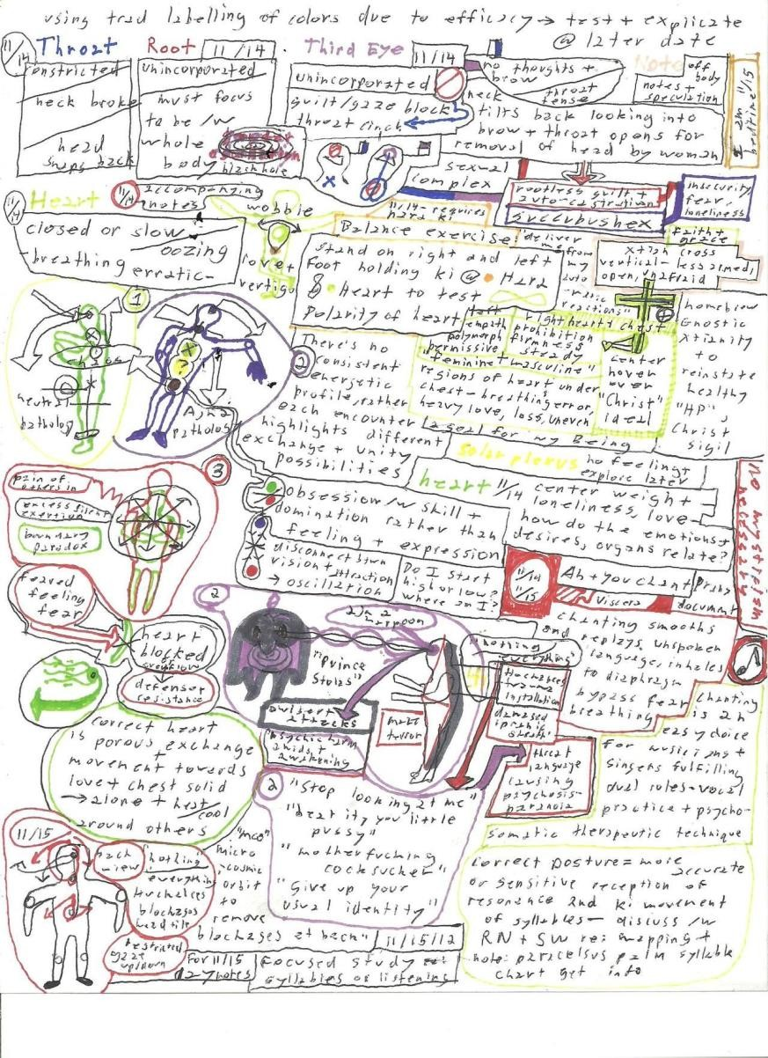


Slide 18
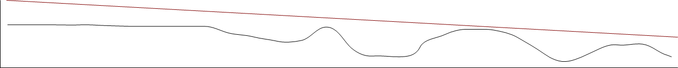
Differential diagnosis:
Other psychotic disorders
Another medical condition causing psychosis -> watch out for delirium and epilepsy
Anxiety disorders (decompensating)
OCD and related disorders (decompensating)
PSTD and related disorders
Dissociative disorder
Personality disorders (Borderline -> micro-psychotic events, Schizotypal, Paranoid type)
Malingering
Factitious Disorder
Neurodevelopmental disorders such as ASD
Course:
Fx
Birth Childhood Adolescence Adulthood Old Age
Duration of untreated psychosis suggests decrease in function, hence Early Intervention in Psychosis Services Studies have shown steady decrease in cortical density fronto-temporal areas as well as thalamic areas of the brain
Changes in cortical thickness during the course of illness in schizophrenia.
van Haren NE1, Schnack HG, Cahn W, van den Heuvel MP, Lepage C, Collins L, Evans AC, Hulshoff Pol HE, Kahn RS. 2011
Cortical Brain Abnormalities in 4474 Individuals With Schizophrenia and 5098 Control Subjects via the Enhancing Neuro Imaging Genetics Through Meta Analysis (ENIGMA) Consortium. van Erp TGM1, Walton E2, Hibar DP3, Schmaal L4, Jiang W5, Glahn DC6, Pearlson GD6, Yao N6, Fukunaga M7, Hashimoto R8, Okada N9, Yamamori H10, 2018

Slide 19
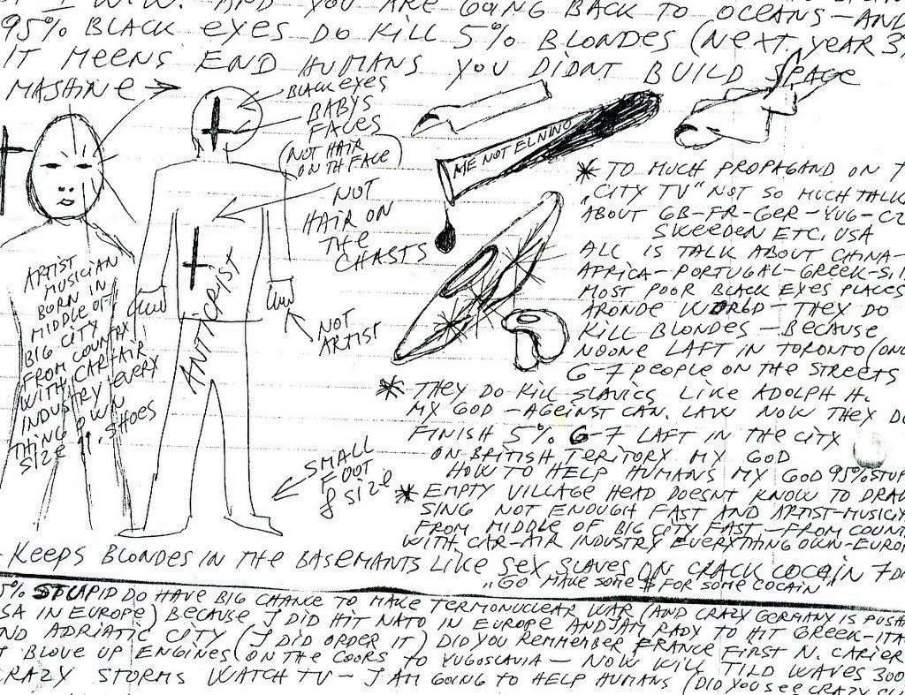

Slide 20


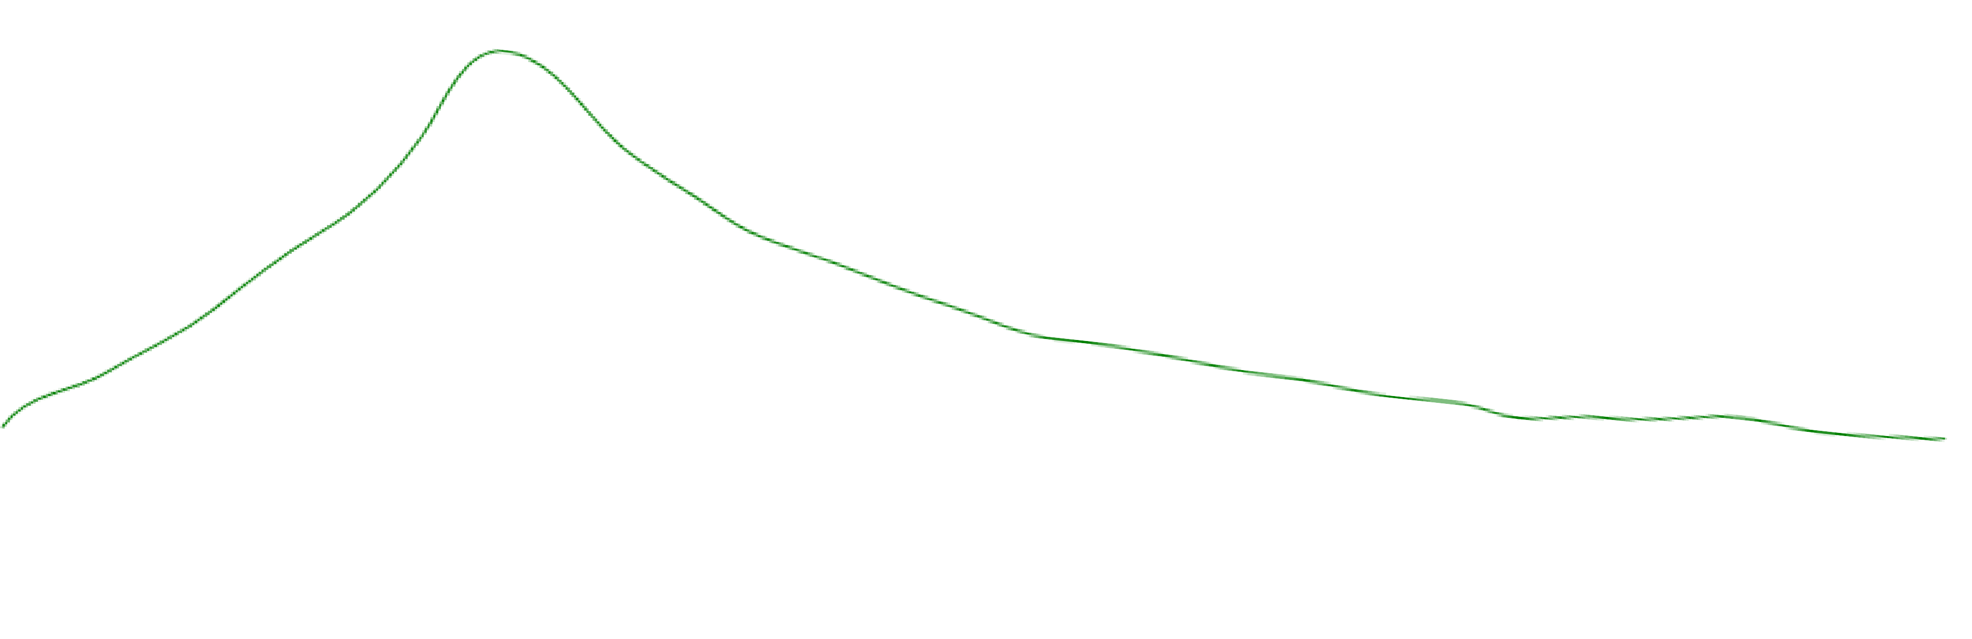
Good Prognostics:
Female
Later onset
Acute onset vs. insidious
Precipitating factors
Normal pre-morbid personality/ function
Good social support/ educational
No negative symptoms or cognitive impairment
No family history and good treatment effect with little to no side effects
Epidemiology
30%
20%
10%
12-14/ 15-19/ 20-24/ 25-30/ 30-34/ 35-39/ 40-44/ 45-49/ 50-59/ 60+

Slide 21
Usually, traits can be seen in early childhood (mostly retrospectively); high-risk factors being:
Hypo-active
Hypotonia, poor 'cuddliness’
Unusual pattern or slow milestones achievement
Soft CNS signs, especially clumsiness or poor coordination.
Deficits in attention and information processing (National Child Developmental Study; Canon et al, Crow et al)
Dichotomy exists regarding schizophrenia being:
Developmental disorder (evidence for low IQ before psychotic symptoms)
Degenerative disorder; but exceptions in literature and media: John Nash, John Ogden, Katherine Routledge etc.
Schizophrenia

Slide 22
Aetiology/ Pathophysiology
Theories only currently:
A. Neuro-chemical
Dopaminergic hypothesis
Theorised that overactivity of the dopamine system in meso-limbic and meso-cortical pathways is responsible for the symptoms of schizophrenia (pos. sx associated with meso-limbic, negative symptoms with meso-cortical).
Further theorised that this leads to erroneous LTD & LTP in combined pathways, and thus follows atrophy of certain areas of the brain, such as the cortices.
Evidence for theory:
Anti-psychotics = DA antagonists (especially D2)
Dopamine agonists can lead to psychosis (cocaine, amphetamine)
Correlation between DA metabolite HVA and severity of illness
Genetic evidence that may prove: COMT, DRD4, AKT1
Evidence against theory:
PET scans examining drug action in living patients challenged the idea that the amount of DA blocking correlated with clinical benefit (some studies showed 90% blockage, with little effect). Correlates with Emsley & Oosthuizen 2001 Haloperidol study.
DA antagonists have an effect in minutes, but the effect takes days to weeks and is not uniform in all individuals.
Atypicals lower affinity for claimed DA receptors; plethora of other receptors as well, equally effective.

Slide 23
Glutamate hypo-activity (NMDA receptors)
5-HT over-activity
GABA hypo-activity in hippocampi
B. Neuro-developmental
Evidence for delayed milestones in childhood.
Abnormal cerebral studies at 1st presentation psychosis
Absence of gliosis
C. Disconnection hypothesis
fMRI/ SPECT showed:
^ Widespread reduced grey matter (could be hypotrophy only due to action of other pathways.
^ Reduction in white matter integrity.
^ Reduced fronto-temporal blood flow.
Neuroimaging of schizophrenia: structuralabnormalities and pathophysiologicalimplications, Peter F BuckleyDepartment of Psychiatry, MedicalCollege of Georgia, Augusta, GA, USA
Neuro-imaging studies by Paum M Thompson et al 2001 & 2009
* Newer molecular imaging techniques a promising future.
D. Others: AN information processing/ neuro-degenerative sans gliosis ect.

Slide 24
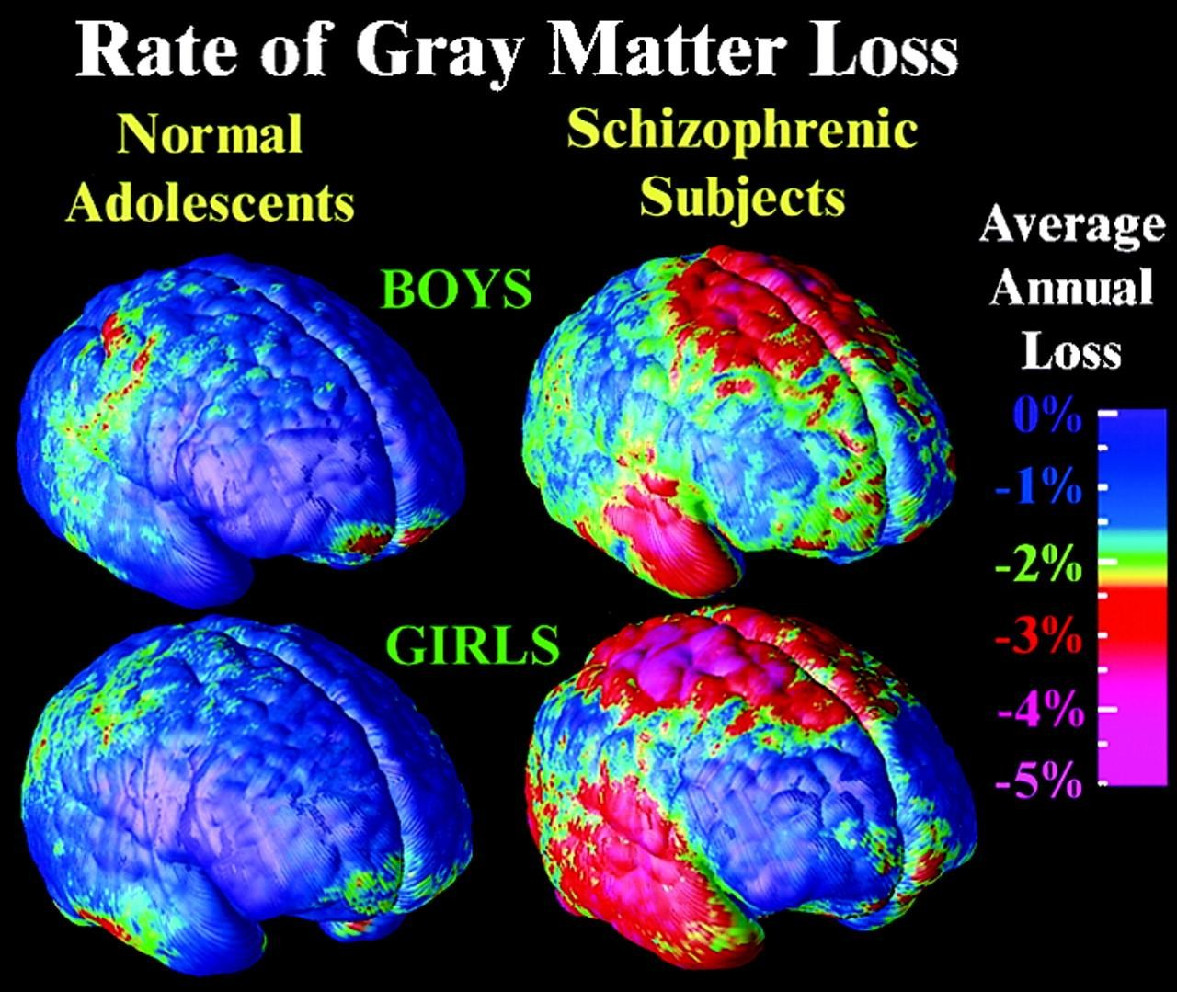
Mapping adolescent brain change reveals dynamic wave of accelerated gray matter loss in very early-onset schizophrenia, Paul M. Thompson et al Sept 2001

Slide 25
E. Genetics/ epigenetics:
MZT: 46% vs DZT: 12 – 15%.
One parent: 12 – 15%; 2 parents: 40%; Grand Parent: 6%; no relatives: 0.5 – 1%
Best evidence in genes (yet sketchy): COMT, DRD4, AKT1RGS4, PPP3CC, ZDHHC8, DISC
Weinberger & Harrison: gene expression analysis = abnormality in mRNA & protein expression.
Jonathan Mills et al (Kings College 2011): epigenetic abnormality = 20% variation in methylation of area ST6GALNAC1 linked to schizophrenia. NB is overmeth of ZNF659 = schizophrenia, but
undermethylation of same area = Bipolar Disorder.
Environmental stressors linked are:
Birth complications.
Childhood brain damage (esp post infection – see 28 year Finnish study; 7x more prone).
Winter birth
Heavy cannabis use esp with COMT gene AN; (still controversial, Swedish and NZ study challenges this idea). But cannabis now showed to reduce adolescent neurocognitive ability by up to 8 IQ points. NZ 10 year study followed 1000 teens into adulthood.

Slide 26
Thus multiple-hit hypothesis seem to be nearest to ‘truth’ about pathophysiology:
Genetic predisposition (COMT genes etc) with,
epigenetic under-/overmethylation due to,
multiple environmental stressors throughout life which can lead to schizophrenia.
Preventative measures:
ID at risk genetics with,
Better peri-natal care.
Prodromal: Psychotherapy, Omega 3, SSRI, monitor early warning signs
1st onset: Anti-psychotics (low dose as possible), social support and education, esp HEE families.
Co-Morbid Medical Illness in Schizophrenia
Up to 80% have a medical illness, up to 50% may be undiagnosed
Co-Morbid substance use/ misuse is high: nicotine 90%, alcohol 40%, use as
Self medication especially for EPS.
Management
As with FEP -> anti-psychotics are currently the only (albeit crude) way of managing the symptoms.
Up to 78% of patients with Schizophrenia will relapse in first year without medication. Up to 90% relapse in second year.
Monitor for early warning signs. PANSS, CAARMS (very limited) etc.
CATIE showed us the high percentage of patients not being treatment compliant.
Insight generally a problem with non-adherence to treatment.
LAI medication has shown to be the current best affective treatment against relapse (latest research).
Continued psych education (patient and family) is very important.

Slide 27
Delusional Disorder
A mental disorder (rare), characterized by a person having a fixed delusion without experiencing other symptoms of psychosis (no perceptual, affect changes or thought from disorder). They can – apart from social relationships, be relatively functional in society. It must be present for more than 1 month.
Delusions can be either bizarre or non bizarre (and is usually non-bizarre, as bizarre delusions are mostly found in schizophrenia).
Other causes for psychotic disorders as previously discussed, MUST be excluded.

Slide 28
Delusional Disorder
Types:
Erotomaniac type (another person in love with the person assessed).
Grandiose type (believing to be exceptional but unrecognized).
Jealous type (theme is that of a belief that the partner is unfaithful in absence of any proof).
Persecutory type (theme of being persecuted in various ways without any proof).
Somatic type ( theme of bodily functions and/ or sensations).
Mixed type (multiple above-mentioned present) -> make sure it is not schizophrenia.
Unspecified type (not clearly the above stated)
Specify with bizarre content if present -> yet again, make sure not schizophrenia.
Management and prognosis
Quite rare, but non-responsive to anti-psychotics. Last mentioned can be used to manage agitation.
Psych education best, but insight almost always remain a problem. This can be challenged with Socratic-based therapy techniques.

Slide 29
DSM-5 Differential
Type | Onset | Length | Psychotic Symptoms | Mood Symptoms | Functional Decline?
Brief psychotic disorder | Sudden | 1 day to 1 month | At least 1 of: • Delusions • Hallucinations • Disorganized speech • Grossly disorganized or catatonic behaviour | No | Full resolution of symptoms
Schizophreniform disorder | Can be prodromal | 1 month to 6 months | At least 2 of: • Delusions • Hallucinations • Disorganized speech • Grossly disorganized or catatonic behaviour • Negative symptoms | No | Not required
Schizophrenia | Can be prodromal | > 6 months | At least 2 of: • Delusions • Hallucinations • Disorganized speech • Grossly disorganized or catatonic behaviour • Negative symptoms | No | Required
Schizoaffective disorder | Can be prodromal | Major mood episode + 2 weeks of psychotic symptoms | • Delusions or hallucinations for 2 or more weeks, which must be in absence of a major mood episode (depressive or manic) during the lifetime duration of the illness | Required | Not required
Delusional disorder | Can be prodromal | > 1 month | • One or more delusions, with no other psychotic symptoms. | No | Normal function aside from impact of delusions

Slide 30
References/ recommended reading
Time-Lapse Mapping of Cortical Changes in Schizophrenia with Different Treatments Cerebral Cortex May 2009;19:1107--1123 doi:10.1093/cercor/bhn152
Functional magnetic resonance imaging in schizophrenia Raquel E. Gur, MD, PhD; Ruben C. Gur, PhD 2010
Abnormal neural connectivity in schizophrenia and fMRI-brain-computer interface as a potential therapeutic approach Sergio Ruiz1,2*, Niels Birbaumer2,3 and Ranganatha Sitaram2,4,5* 2013
DiagnosticClassificationofSchizophrenia PatientsontheBasisofRegionalRewardRelatedfMRISignalPatterns StefanP.Koch1*,ClaudiaHägele1,John-DylanHaynes2,AndreasHeinz1, FlorianSchlagenhauf1,3,PhilippSterzer1 2014
CATIE & Cutlass trials. DOI: 10.1192/bjp.bp.107.037218
Kaplan & Sadock’s Comprehensive Textbook of Psychiatry, 10th edition, Walters Kluwer 2017 The Maudsley Prescribing Guidelines in Psychiatry, 13th Edition
David M. Taylor, Thomas R. E. Barnes, Allan H. Young
Stahl’s Essential Psychopharmacology 4th edition DSM-5 vs ICD-11 (recently released)
A Critique of the Dopamine Hypothesis of Schizophrenia and Psychosis
Joanna Moncrieff, MBBS, MSc, MD, MRCPsych 2009; DOI: 10.1080/10673220902979896

